Slide 1



POSCO International CRM Innovation
User Manual_ Account&Contact
2025. 10

Slide 2
Contents_PC
Step 1
Account Management
Account View 1. View list of accounts 2. View detailed account information
Account Update 1. Update account information 2. Create Account Card 3. Manage account organization chart
Account Creation 1. Create an account not linked to BP 2. Convert to a BP-linked account

Slide 3
Contents_PC
Step 2
Contact Management
Contact View 1. View contact list 2. View detailed contact information
Contact Update 1. Update contact information
Contact Creation 1. Create a single contact 2. Create multiple contacts

Slide 4
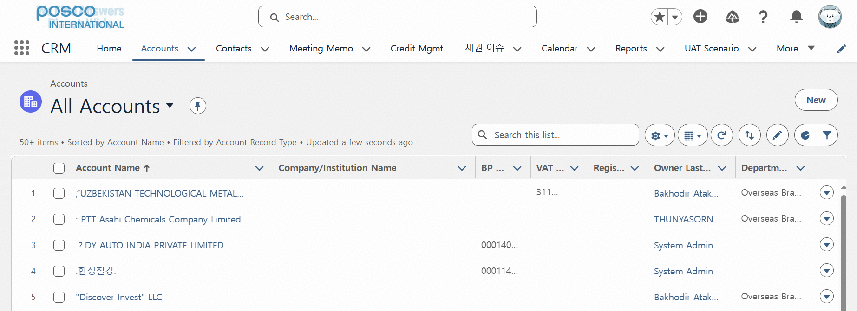
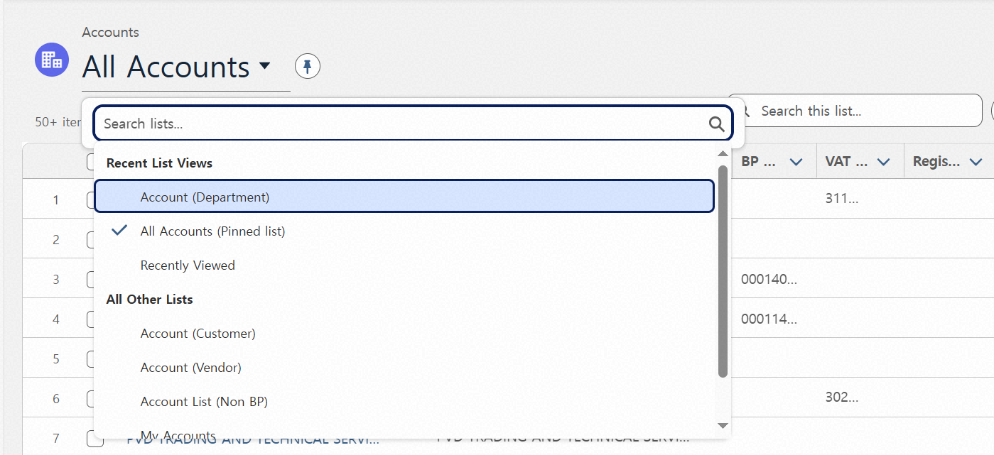
Step 01. Account Management
Step (Lv.2) | 01.01. Account View | Step (Lv.3) | 01.01.01 View list of accounts
Menu | Account
Navigation | CRM App > Account > Account List
“거래선 List 목록” 클릭 - 클릭시, 조회 기준별 거래선 리스트를 표기하여 줌
List View 종류에 따른 조회 기준 - 내 거래선: 본인이 생성한 거래선 - 모든 거래선: 전체 등록 거래선 - 최근 조회 항목 : 최근 조회한 거래선(정렬 불가/최신순) - 최근에 본 거래선 : 최근에 본 거래선(정렬 가능) - Account (Customer) : Customer 유형의 거래선 - Account (Vendor) : Vendor 유형의 거래선 - Account (Department) : 내 조직 기준으로 관리 중인 거래선 - Account (Non BP) : BP 연결 전 거래선
Click “Account List” - When clicked, a list of accounts is displayed based on the selected search criteria.
List View Types - My Accounts: Accounts created by the user - All Accounts: All registered accounts - Recently Searched Items: Accounts recently searched (Unsortable) - Recently Viewed Accounts: Accounts recently viewed (Sortable) - Account (Customer): Accounts categorized as Customer type - Account (Vendor): Accounts categorized as Vendor type - Account (Department): Accounts managed based on the user's organization - Account (Non BP): Accounts not yet linked to a Business Partner (BP)
1
2

Slide 5
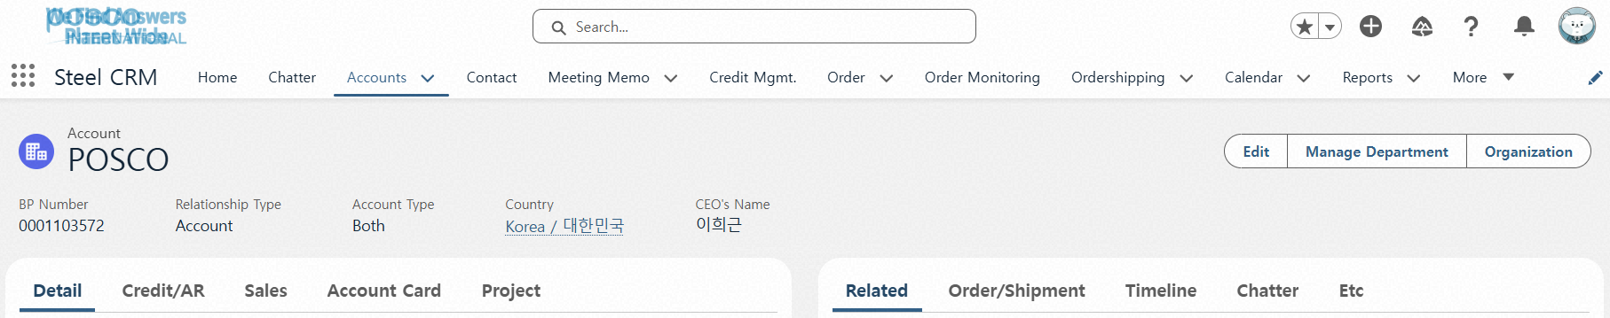
Step 01. Account Management
Step (Lv.2) | 01.01. Account View | Step (Lv.3) | 01.01.02 View detailed account information
Menu | Account
Navigation | CRM App > Account > Account List > Account Details View
상단 주요 정보 영역 - 거래선 정보 중 주요한 정보가 상단에 노출 진행 됨
탭별 세부 정보 조회 - 기본정보탭: 기업의 기본 정보와 SAP 연계 정보, 나이스 D&B 연계 정보가 노출됨 - 여신/채권탭: 거래선 기준의 여신, 채권 정보 노출 - 매출정보: 거래선 기준 매출 노출 - 고객사 카드: 거래선 정보 기준 문서 생성 기능 및 정보 작성 탭 - 관련정보: 연결된 연락처, 미팅메모, 선물 정보 노출 - 출하/재고: 거래선별 출하/재고 노출 - Timeline: 거래선 기준 이벤트/업무 등록 및 조회 화면 - Chatter: 거래선 기준 게시판 - 기타정보: 취급품목 정보, 담당조직 정보 등 부가적인 정보가 노출됨
Top Key Information Area Displays key Account information at the top of the screen.
View Detailed Information by Tab - Detail Tab: Shows company basic information, SAP integration details, and Nice D&B data. - Credit/AR Tab: Displays credit and receivables information based on the Account. - Sales Tab: Shows sales data based on the Account. - Account Card Tab: Allows document creation and information entry based on Account details. - Project Tab: Displays information on projects and long-term contracts linked to the account. - Related Tab: Displays linked contacts, meeting notes, and gift information. - Order/Shipment Tab: Shows shipment and order data per Account. - ETC Tab: Displays additional information such as handled items and responsible organizations.
1
2

Slide 6
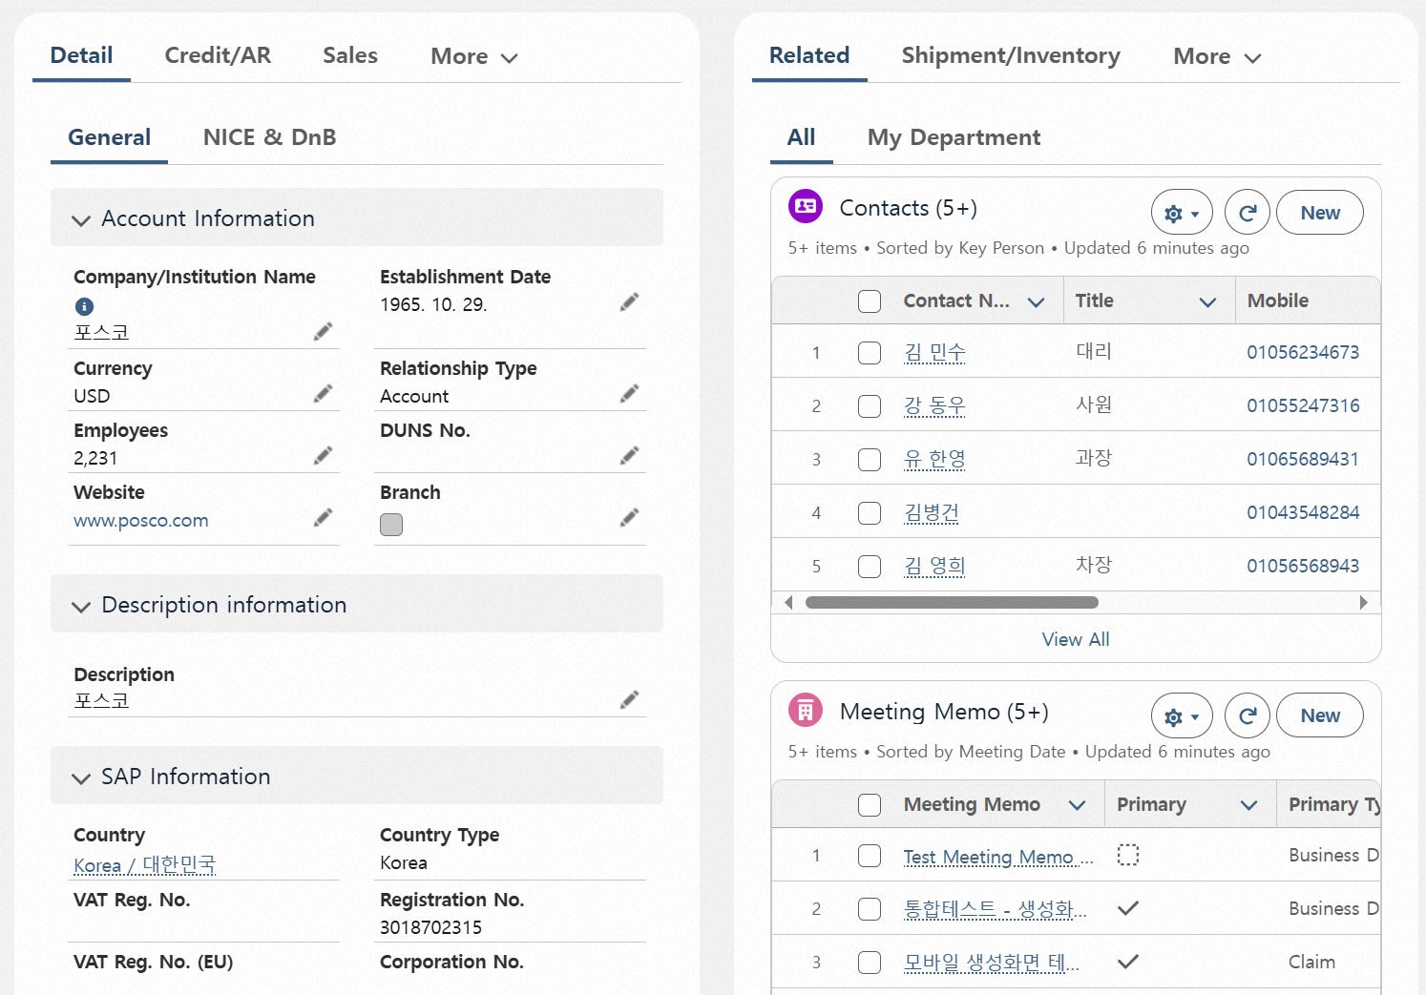
Step 01. Account Management
Step (Lv.2) | 01.01. Account View | Step (Lv.3) | 01.01.02 View detailed account information
Menu | Account |  | (General Information)
Navigation | CRM App > Account > Account List > Account Details View
Account Information Section - This section contains the most basic and essential information about the account. - Most fields in this section are mandatory.
Description Section - This area displays a text-based description of the company.
SAP I/F Information - Shows data retrieved from the SAP system during integration. - This information is read-only and cannot be edited in Salesforce.
NiceD&B Information Tab - When clicked, this tab displays company data integrated from NiceD&B. - Users can view a company overview and financial information for the past three years. - This information is also read-only and cannot be modified.
4
1
2
3

Slide 7
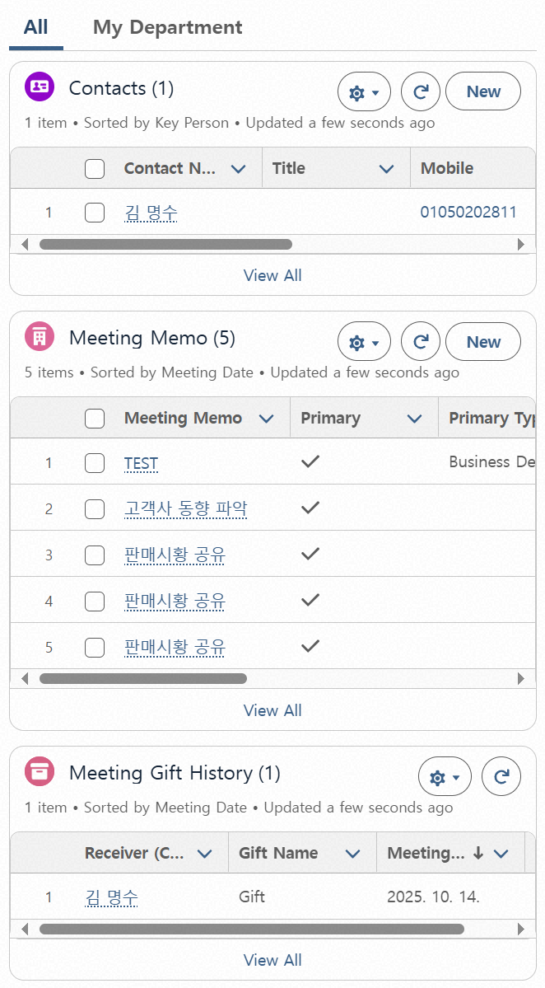
Step 01. Account Management
Step (Lv.2) | 01.01. Account View | Step (Lv.3) | 01.01.02 View detailed account information
Menu | Account |  | (Related)
Navigation | CRM App > Account > Account List > Account Details View
Connected Contacts List - Displays name, job title, mobile phone number, email, and marks key contacts. - Clicking the “New” button allows you to add a new contact.
Connected Meeting Notes List - Shows meeting note title, key account status, type, meeting date, department that created it, and summary information. - Clicking the “New” button allows you to create a new meeting note.
Meeting Gift History List - Displays the list of “Meeting Gift History” recorded in the connected meeting notes. - Shows recipient, gift name, and meeting date.
Clicking the ‘My Organization’ Tab - Filters content based on the organization of the logged-in user. - For upper-level organizations, includes content from subordinate organizations.
4
1
2
3

Slide 8
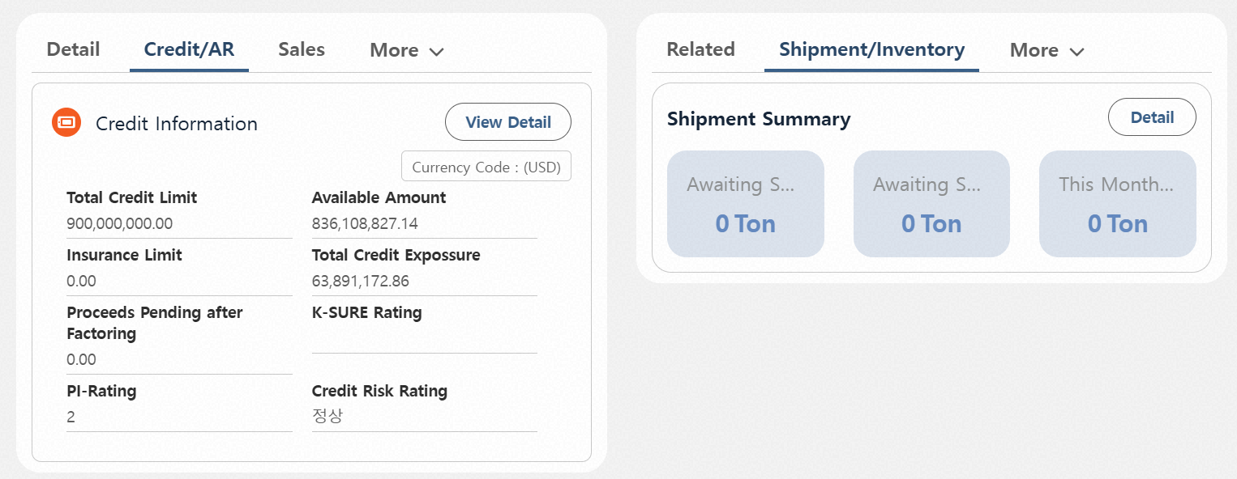
Step 01. Account Management
Step (Lv.2) | 01.01. Account View | Step (Lv.3) | 01.01.02 View detailed account information
Menu | Account |  | (Credit/ A/R)
Navigation | CRM App > Account > Account List > Account Details View
Credit Information Section - Displays credit information of business partners based on the corporation the user belongs to. - Clicking “View Details” switches to the Credit Monitoring Dashboard screen.
1

Slide 9
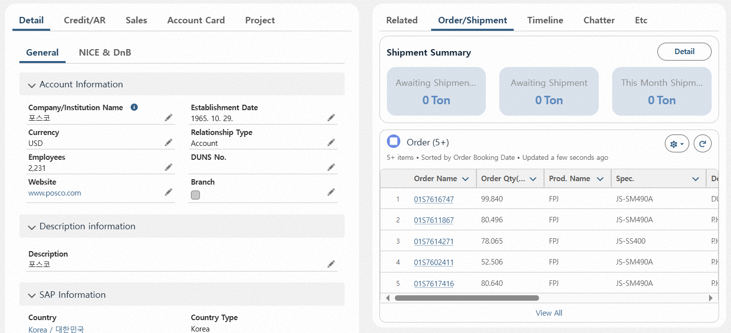
Step 01. Account Management
Step (Lv.2) | 01.01. Account View | Step (Lv.3) | 01.01.02 View detailed account information
Menu | Account |  | (Order/Shipment)
Navigation | CRM App > Account > Account List > Account Details View
Shipment Status Information Section - Displays shipment information of business partners based on the organization the user belongs to (Only Steel Division). - Clicking “Details” switches to the Order/Shipment Monitoring Dashboard screen.
Order Information Section - A list of order information linked to the related Account.
1
2

Slide 10
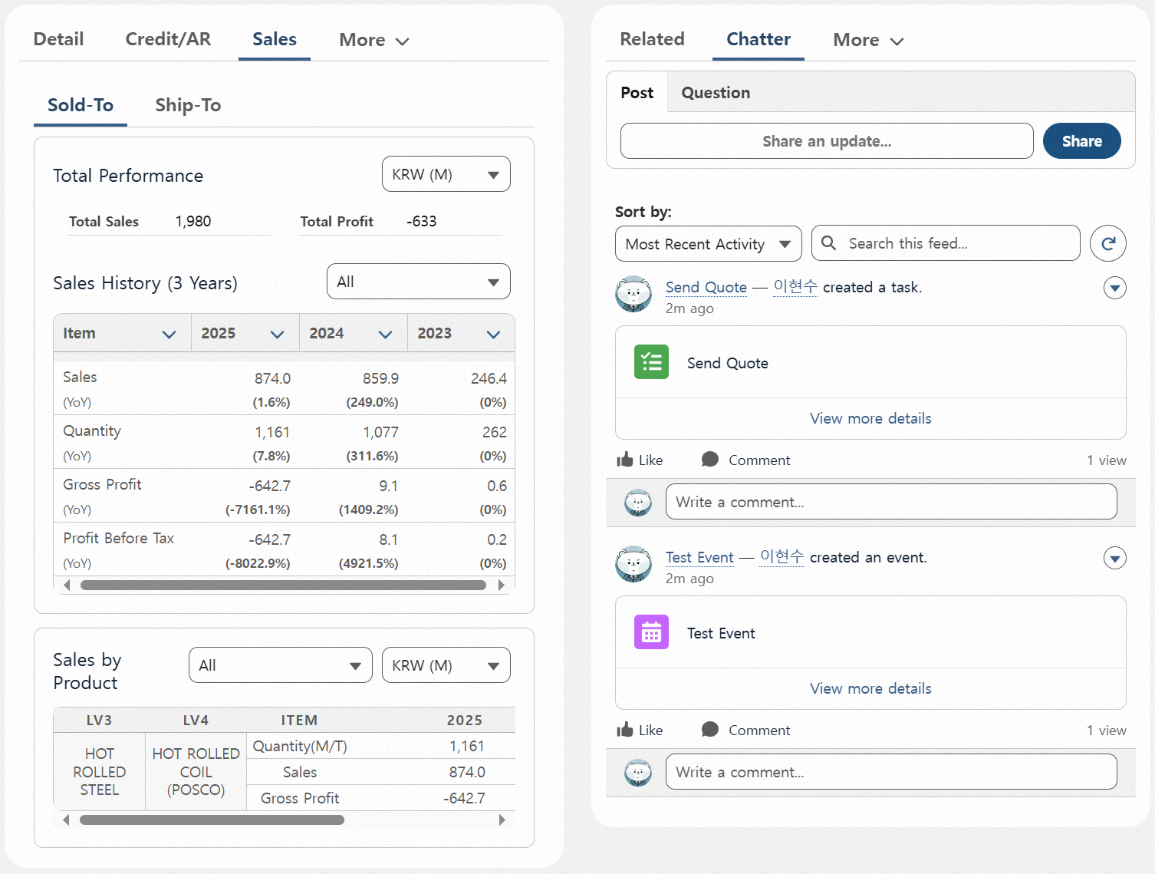
Step 01. Account Management
Step (Lv.2) | 01.01. Account View | Step (Lv.3) | 01.01.02 View detailed account information
Menu | Account |  | (Sales) (1/2)
Navigation | CRM App > Account > Account List > Account Details View
Sales by Account - Displays annual sales, gross profit, and pre-tax profit (shown for the past 3 years).
Currency/Unit Selection Filter for Amount Display - Provides 4 options: KRW (Won / million Won), USD (Dollar / thousand Dollar).
Organization Selection Filter - For users with department head level or key roles, sales data can be viewed based on their affiliated department/division.
Sales by Item per Account - Displays annual sales by item. - Quantity, sales, and profit are shown per item.
Sales Data Reference Standard - Based on SAP Billing. - Can be viewed by both Sold-To and Ship-To.
5
1
2
3
4

Slide 11
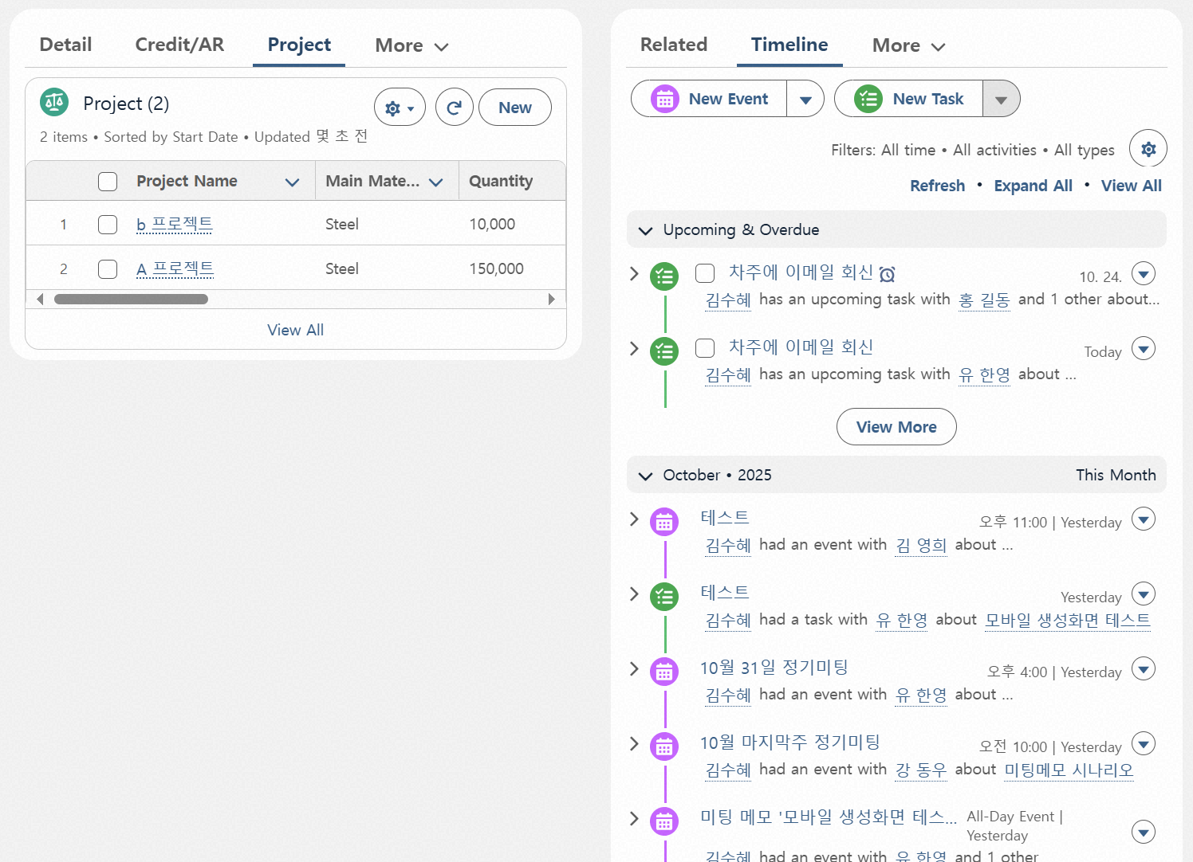
Step 01. Account Management
Step (Lv.2) | 01.01. Account View | Step (Lv.3) | 01.01.02 View detailed account information
Menu | Account |  | (Project)
Navigation | CRM App > Account > Account List > Account Details View
Contract/Project Management Section - To be filled out when there is a long-term contract or project-based transaction with the customer - Can only be modified or deleted if created by your own organization - Duplicate registration with the same contract/project name is not allowed - Can be created regardless of the customer’s managing organization and can be mapped to order(Only Steel Division) information
1

Slide 12
Step 01. Account Management
Step (Lv.2) | 01.01. Account View | Step (Lv.3) | 01.01.02 View detailed account information
Menu | Account |  | (Timeline)
Navigation | CRM App > Account > Account List > Account Details View
Click “New Event” - Allows you to create a schedule related to the account.
Click “New Task” - Allows you to create a to-do item related to the account.
Timeline History Section - Includes a TO-DO List area showing registered tasks and upcoming events, and a History area showing past events.
1
2
3
TO-DO List
Timeline history

Slide 13
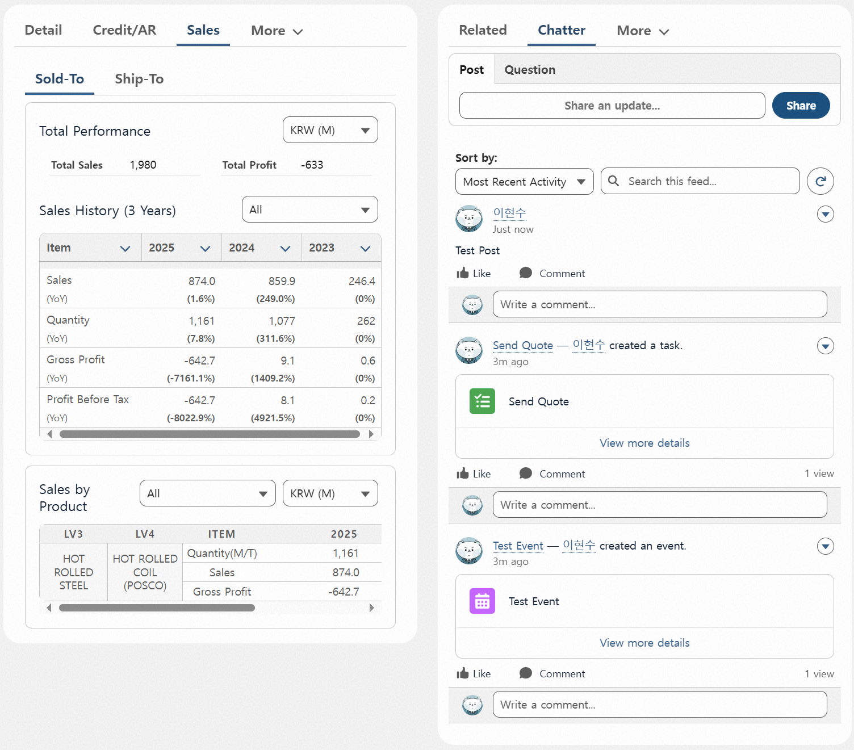
Step 01. Account Management
Step (Lv.2) | 01.01. Account View | Step (Lv.3) | 01.01.02 View detailed account information
Menu | Account |  | (Chatter)
Navigation | CRM App > Account > Account List > Account Details View
Post Creation Section - Allows users to write work-related posts or questions based on the account. - All created posts are visible to everyone.
Sorting and Searching Created Posts - Posts can be sorted and searched.
Created Posts - Posts are displayed in reverse chronological order by default, and all posts allow comments.
Created Events/Tasks - When an event or task is created, it appears in the chatter feed similar to a post, and comments can be added.
1
2
3
4

Slide 14
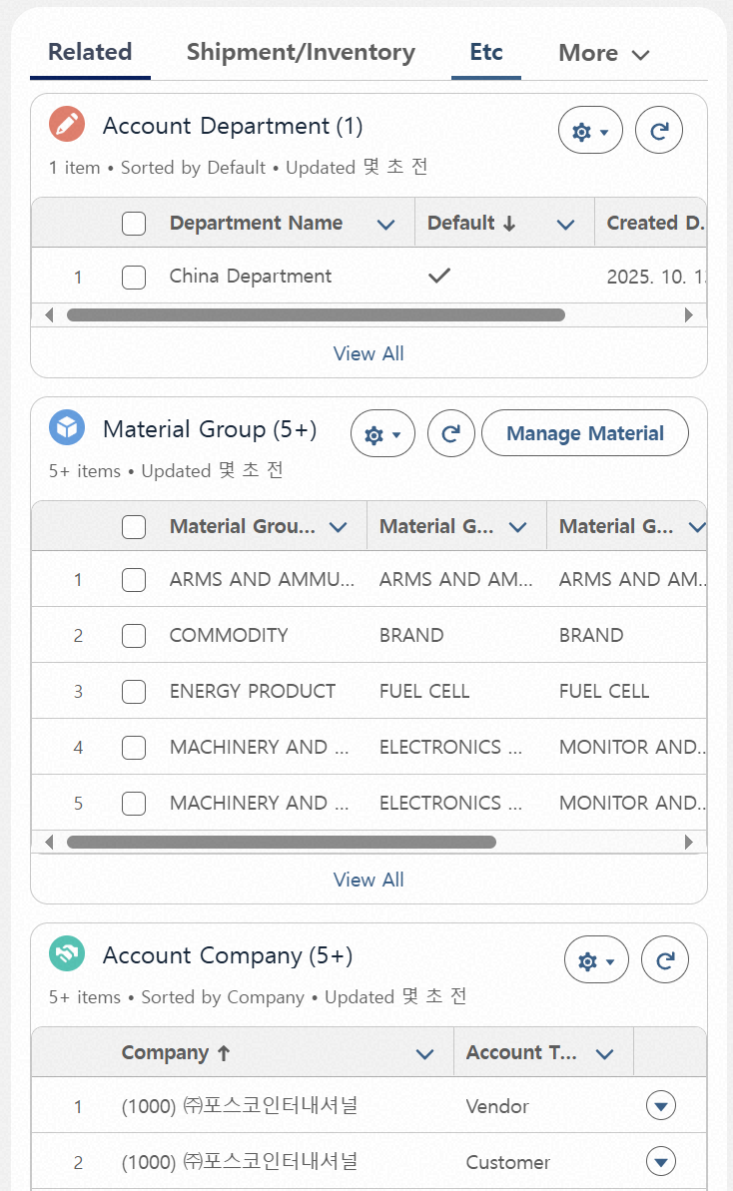
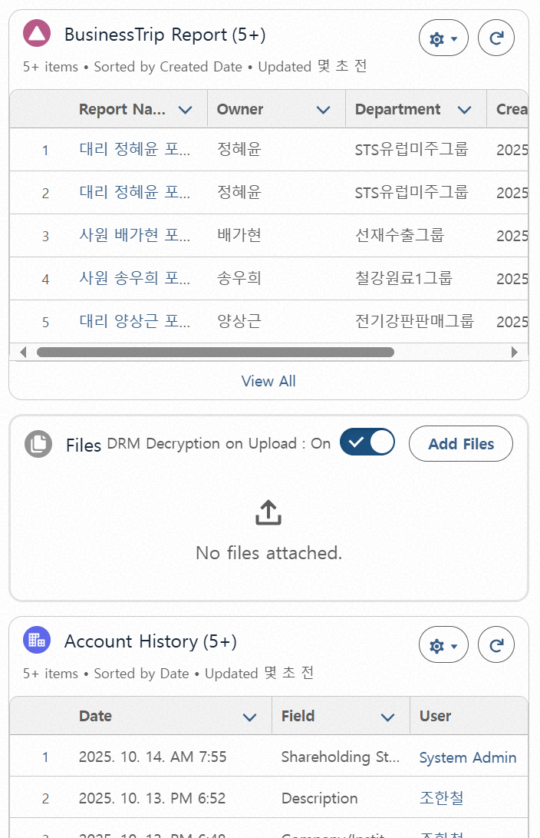
Step 01. Account Management
Step (Lv.2) | 01.01. Account View | Step (Lv.3) | 01.01.02 View detailed account information
Menu | Account |  | (Etc. Information)
Navigation | CRM App > Account > Account List > Account Details View
Responsible Organization Display Section for the Account - Shows the organization that has permission to edit the account information.
Exposed Items Handled by the Account - Items that can be added based on the responsible organization. - Follows the Material Group standard in SAP.
Account Code Information Display Section - If the account is linked as a BP or extended to an overseas entity, the relevant corporate information is shown.
Legacy Business Trip Report Display Section - Shows older business trip reports managed in the Interzone system, linked by account.
File Upload Section Based on Account - Allows file uploads with optional decryption settings.
Account Modification History Section - Displays the history of changes made to the account.
4
1
2
5
3
6

Slide 15
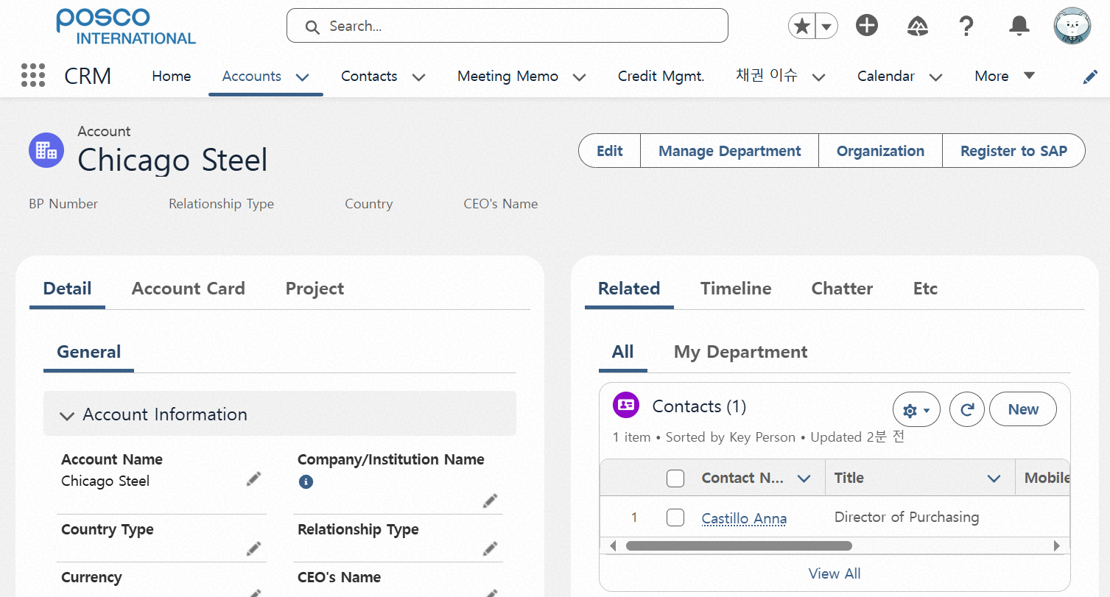
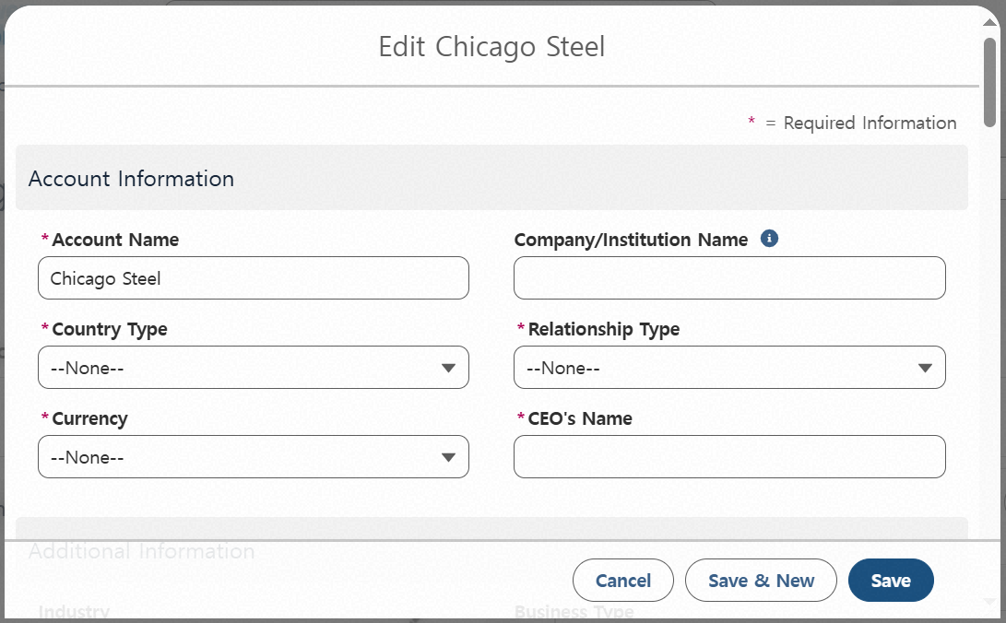
Step 01. Account Management
Step (Lv.2) | 01.02. Account Update | Step (Lv.3) | 01.02.01 Update account information(1/2)
Menu | Account
Navigation | CRM App > Account > Account List > Account Details View
Click “Edit” Button - Opens a popup that allows editing of the account. - Only editable data fields can be modified. (* Fields like basic information can also be edited by clicking the pencil icon.)
After Filling Out the Edit Popup, Click “Save” - Upon saving, the account information is updated. - Duplicate checks are performed during editing as well (e.g., when modifying business registration number or VAT ID).
Organization Chart Setup for the Account - Not a mandatory section; can be configured if needed. - Clicking the organization chart opens the setup screen. - Detailed organization chart settings are available.
1
3
2

Slide 16
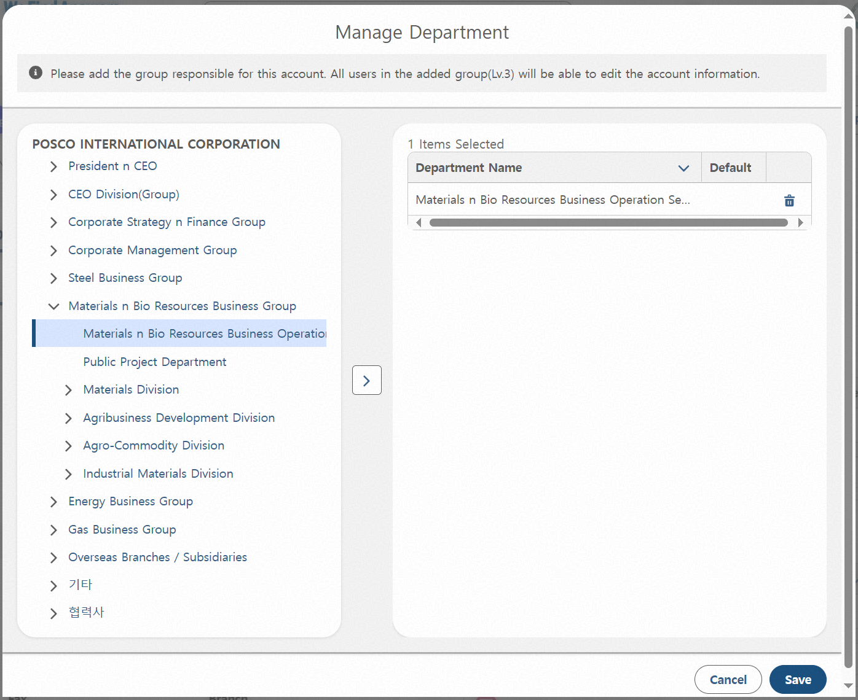
Step 01. Account Management
Step (Lv.2) | 01.02. Account Update | Step (Lv.3) | 01.02.01 Update account information(2/2)
Menu | Account
Navigation | CRM App > Account > Account List > Account Details View
Click “Manage Department” Button - Opens a popup where responsible Departments can be added or removed. - This button is only visible to the owner of the account and its responsible Departments.
After Selecting a Department, Click the Right Arrow - Adds the selected Department (from the left) as a responsible Department for the account. - The added Department gains editing permissions. - By default, group-level Departments can be added, and direct groups/sections under the division or department can also be added.
Clicking the Delete Icon - Removes the selected Department from the editable list.
Clicking “Save” - Applies the changes made to the responsible Department settings.
1
3
2
4

Slide 17
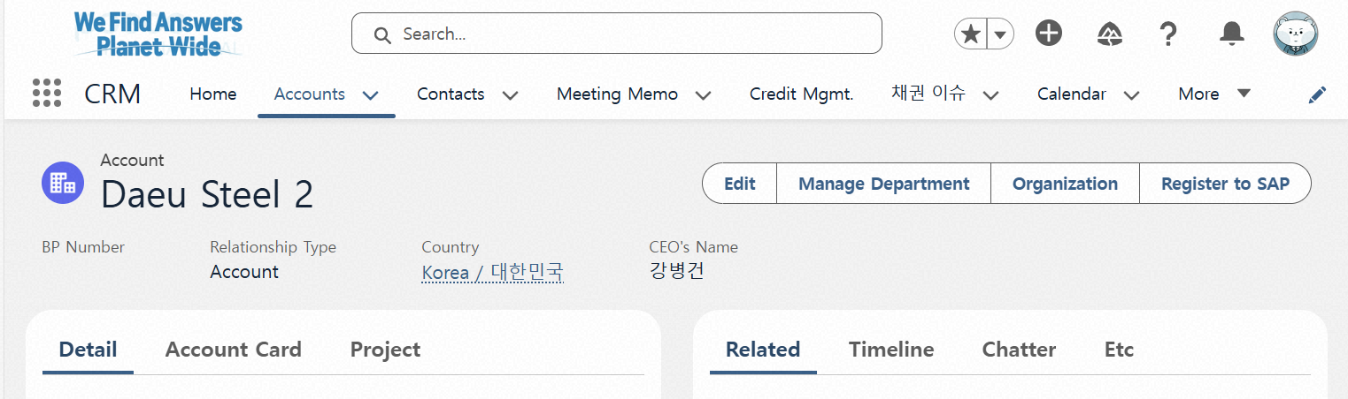
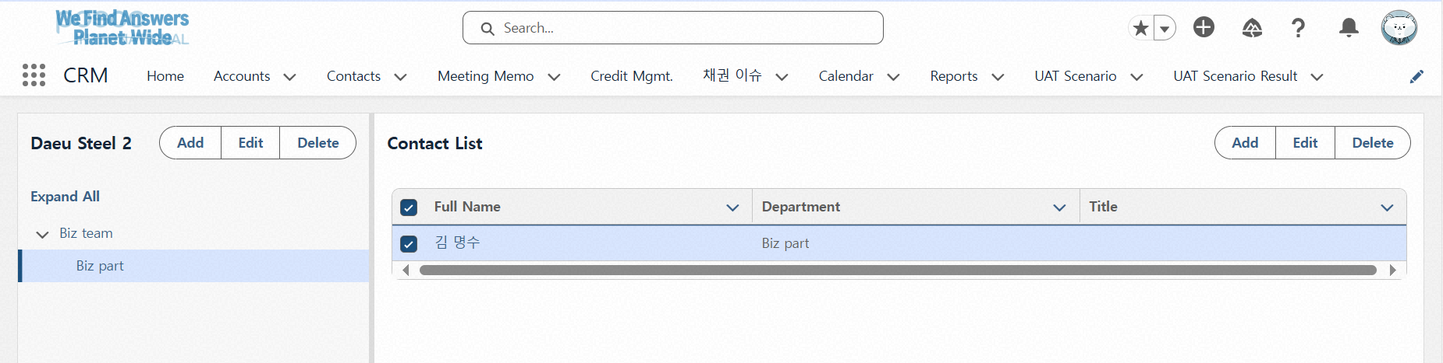
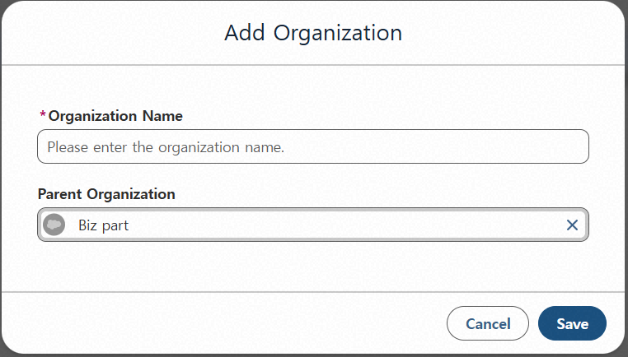
Step 01. Account Management
Step (Lv.2) | 01.02. Account Update | Step (Lv.3) | 01.02.02 Manage account Organization Chart
Menu | Account
Navigation | CRM App > Account > Account List > Organization chart
Click “Add” for Organization - Opens a popup to register an organization, allowing you to set the organization name and its parent organization. - If no parent organization is entered, it will be registered as a top-level organization. After selecting an organization, clicking the Add button will set it as the parent organization.
Click “Edit” for Organization - After selecting a saved organization and clicking "Edit", you can change its name and parent organization information.
Click “Delete” for Organization - Deletes the selected organization.
Click “Add” in the Contact List - You can link contacts to an organization - The contact must be associated with an Account to be related.
Click “Edit” in the Contact List - Modify the organization information linked to the contact.
Click “Delete” in the Contact List - Unlinks the contact from the organization.
Switching pages
1
2
3
4
5
6

Slide 18
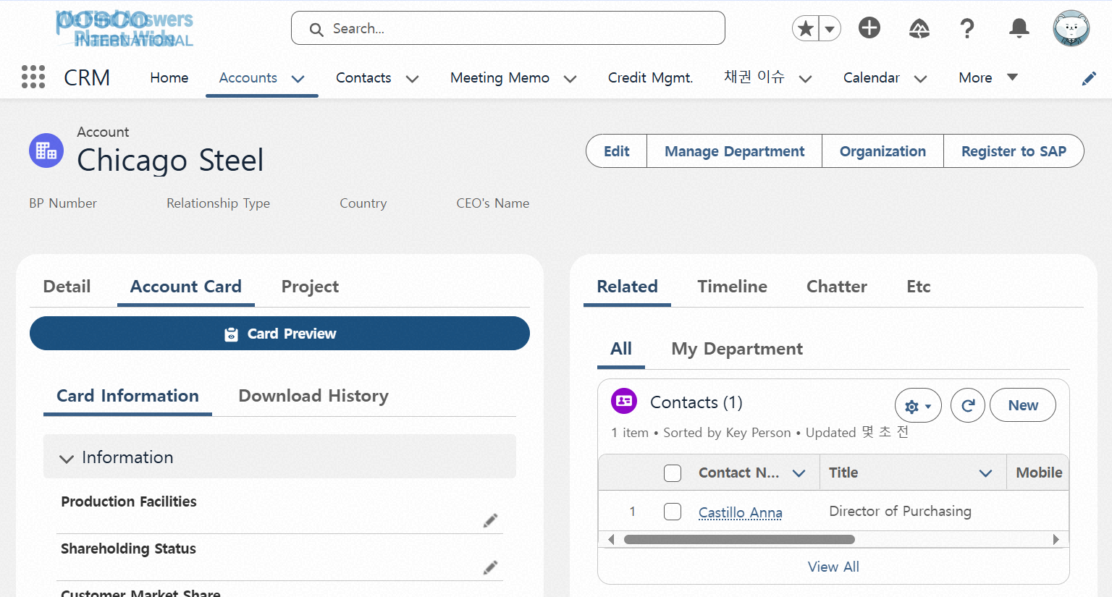
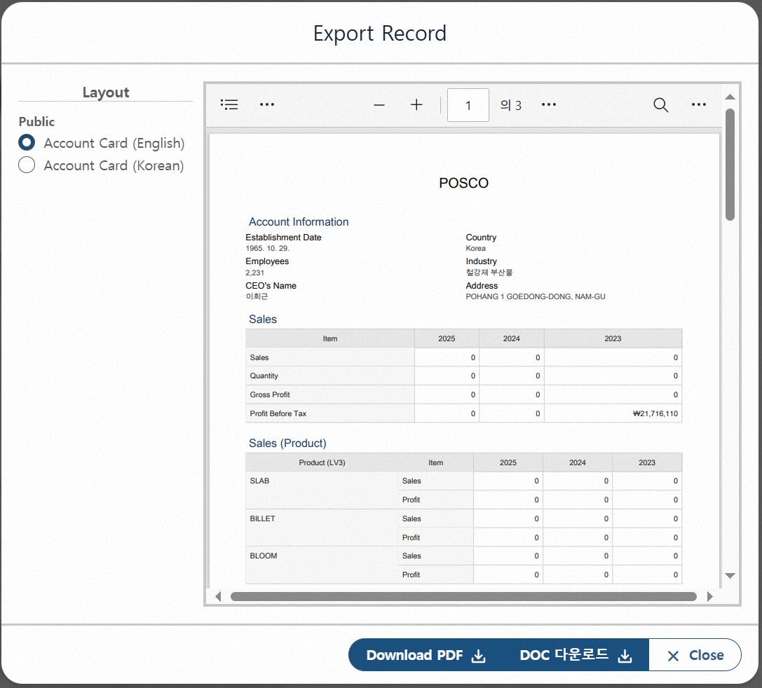
Step 01. Account Management
Step (Lv.2) | 01.02. Account Update | Step (Lv.3) | 01.02.02 Create Account Card
Menu | Account
Navigation | CRM App > Account > Account List > Account Details View
When Clicking “Preview Account Card” - Opens a popup preview of the Account Card document, based on the account’s basic information and the card details entered below. - From the preview popup, the card can be downloaded as a PDF or DOC file.
Card Information Entry Section - A description input area where both text and images can be pasted.
Download History Section - Allows users to view the history of previously generated Account Cards.
1
3
2

Slide 19
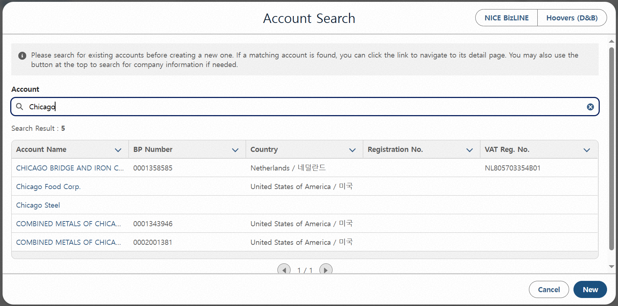
Step 01. Account Management
Step (Lv.2) | 01.03. Account Creation | Step (Lv.3) | 01.03.01 Create an account not linked to BP
Menu | Account |  | (1/3)
Navigation | CRM App > Account > Account List > New Create Pop-up
Click “New” button - Opens a popup to create a new Account. You can check existing records through search.
Search Account Information Based on External Data - Provides popups for Nice BizLine and Hoovers to pre-search company information.
Account Name-Based Search Result Area - Allows initial judgment on duplicate Accounts based on the Account name.
Search Result List Provided - Displays information to help determine duplication. - Criteria for duplication: Business Registration Number VAT Identification Number
Click “New” in the popup page - When clicked, transitions to the next popup. - In the next popup, you can enter detailed Account information.
1
2
3
4
5

Slide 20
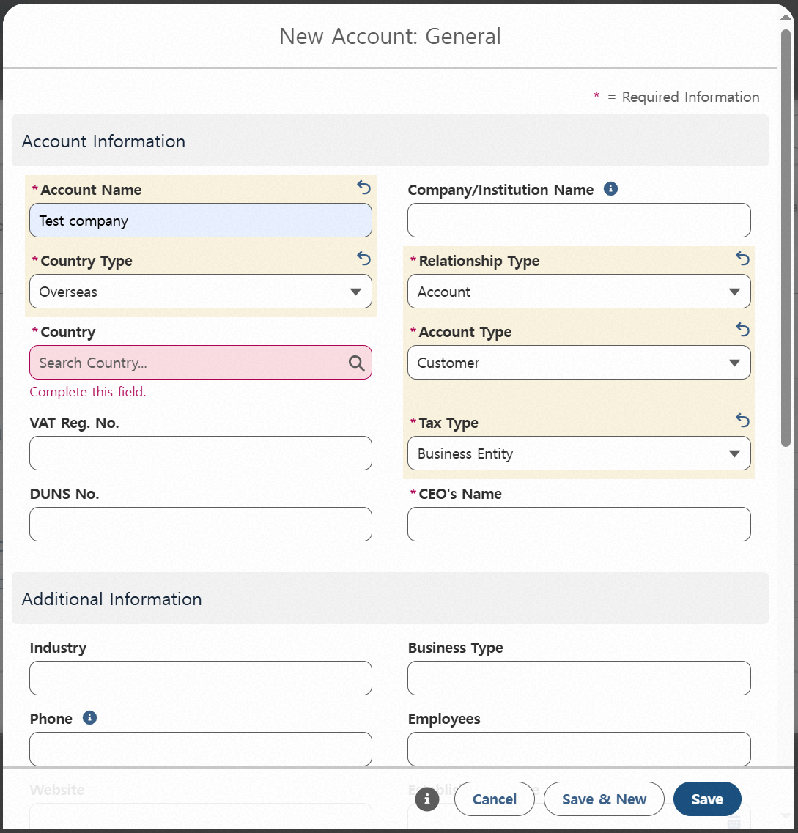
Step 01. Account Management
Step (Lv.2) | 01.03. Account Creation | Step (Lv.3) | 01.03.01 Create an account not linked to BP
Menu | Account |  | (2/3)
Navigation | CRM App > Account > Account List > New Create Pop-up
Select Country Classification - Choose between Domestic or Overseas - Domestic: Business Registration Number is required - Overseas: VAT ID is required (DUNS Number is provided as an optional)
Select Country Type - For Domestic, South Korea is automatically set - For Overseas, search and select the country manually
Select Relationship Type - Choose one of the following: Account, Partner, or Government Relations - If Account is selected, additional selection of Account Type is required
Select Account Type - Choose one: Customer, Vendor, or Both - If Customer is selected, Tax Type selection is required
1
3
2
4

Slide 21
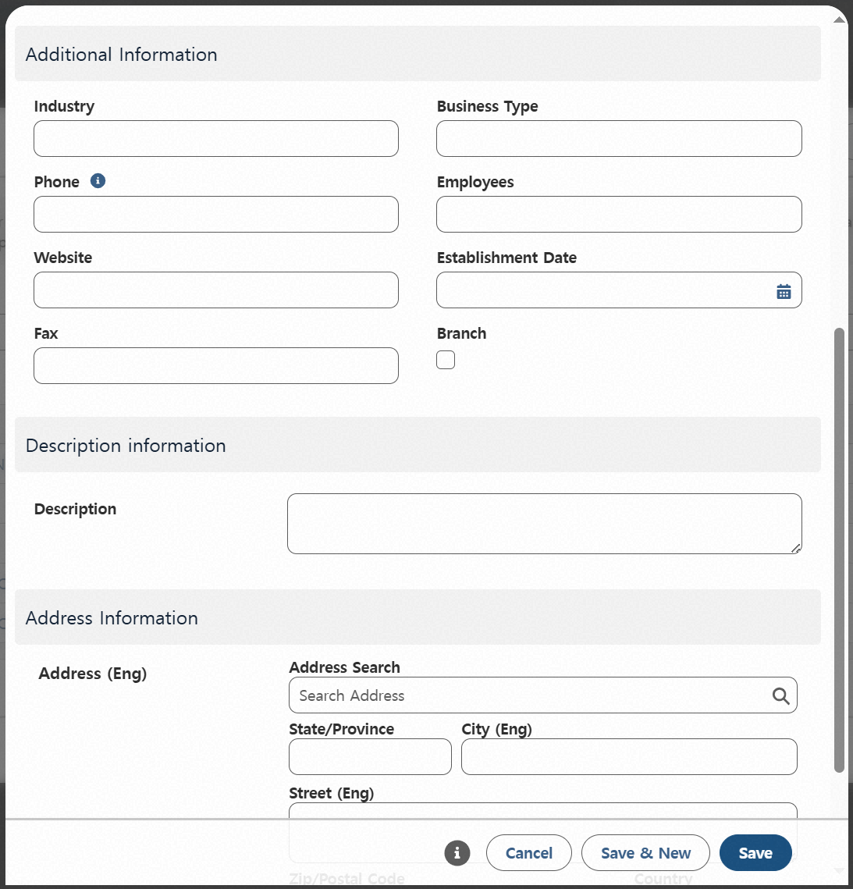
Step 01. Account Management
Step (Lv.2) | 01.03. Account Creation | Step (Lv.3) | 01.03.01 Create an account not linked to BP
Menu | Account |  | (3/3)
Navigation | CRM App > Account > Account List > New Create Pop-up
Enter Additional Information - This area is for entering supplementary information for management purposes.
Enter Description Text for the Account - Write descriptive information about the Account.
Address Information - Address data will be linked when converting to SAP BP later.
Click “Cancel” - Returns to the previous popup.
Click “Save and New” - Saves the current entry and reopens the popup.
Click “Save” - Checks for duplicates before saving. After saving, navigates to the screen of the newly created Account. (* Once saved, a summary will be displayed on the home screen.)
1
2
3
5
6
4

Slide 22
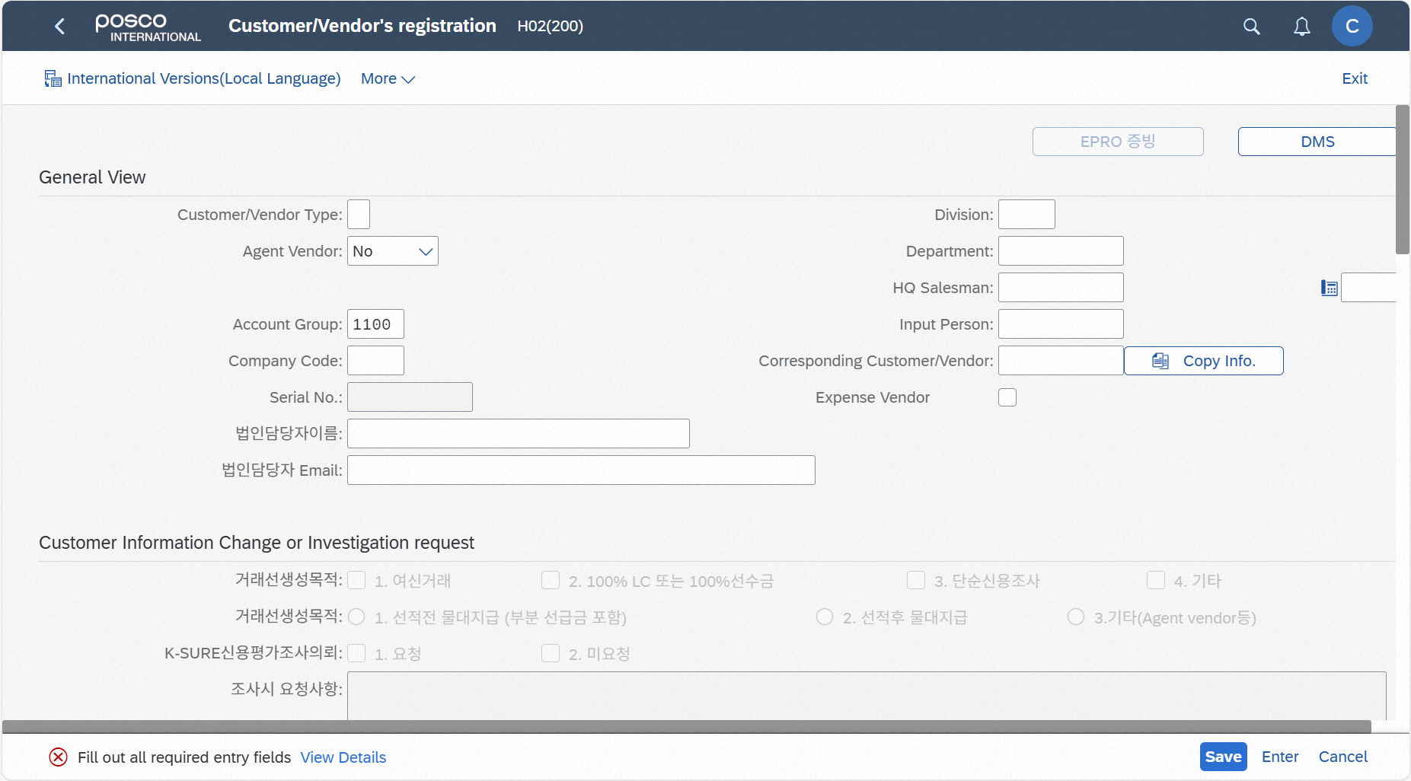
Step 01. Account Management
Step (Lv.2) | 01.03. Account Creation | Step (Lv.3) | 01.03.02 Convert to a BP-linked account
Menu | Account
Navigation | CRM App > Account > Account List > Account Details View
Click “Register in SAP” - This button is only visible for Accounts not yet linked to a BP. - When clicked, a popup for BP registration in SAP will appear. ※ Access is not available in external networks, and only users who have been assigned an SAP ID can use it.
The BP registration screen will open after the SSO login popup appears (about 5–10 seconds) - After saving BP information, the subsequent procedures must be carried out in SAP (e.g., approval request submission, BP approval, etc.)
1
2

Slide 23
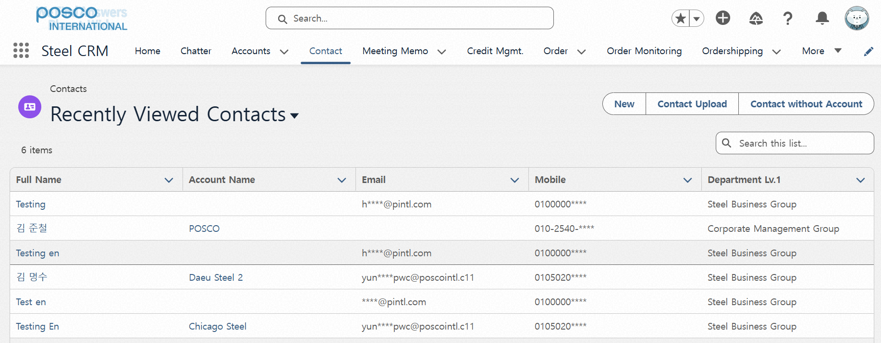
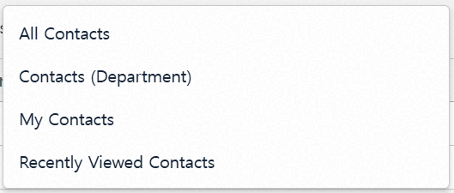
Step 02. Contact Management
Step (Lv.2) | 02.01. Contact View | Step (Lv.3) | 02.01.01 View contact list
Menu | Contact
Navigation | CRM App > Contact > Contact List
Click “Contact List” - When clicked, a list of contacts is displayed based on the selected search criteria.
Search Conditions by List View - All Contacts: All Registered Contacts - Contact (Department): Contacts managed based on the user’s organization - My Contacts: Contacts created by the user - Recently Viewed Contacts: Contacts recently viewed (sortable)
Contact Access Permissions Are Based on the Following Groups:
1) Steel Division, Materials & Bio Division, Overseas Division 2) Gas Business Division, Energy Business Division
3) Corporate Support, Corporate Planning, Partners, Others
(* According to company’s internal Privacy Policy, email addresses and mobile phone numbers are masked in the list view.)
1
2

Slide 24
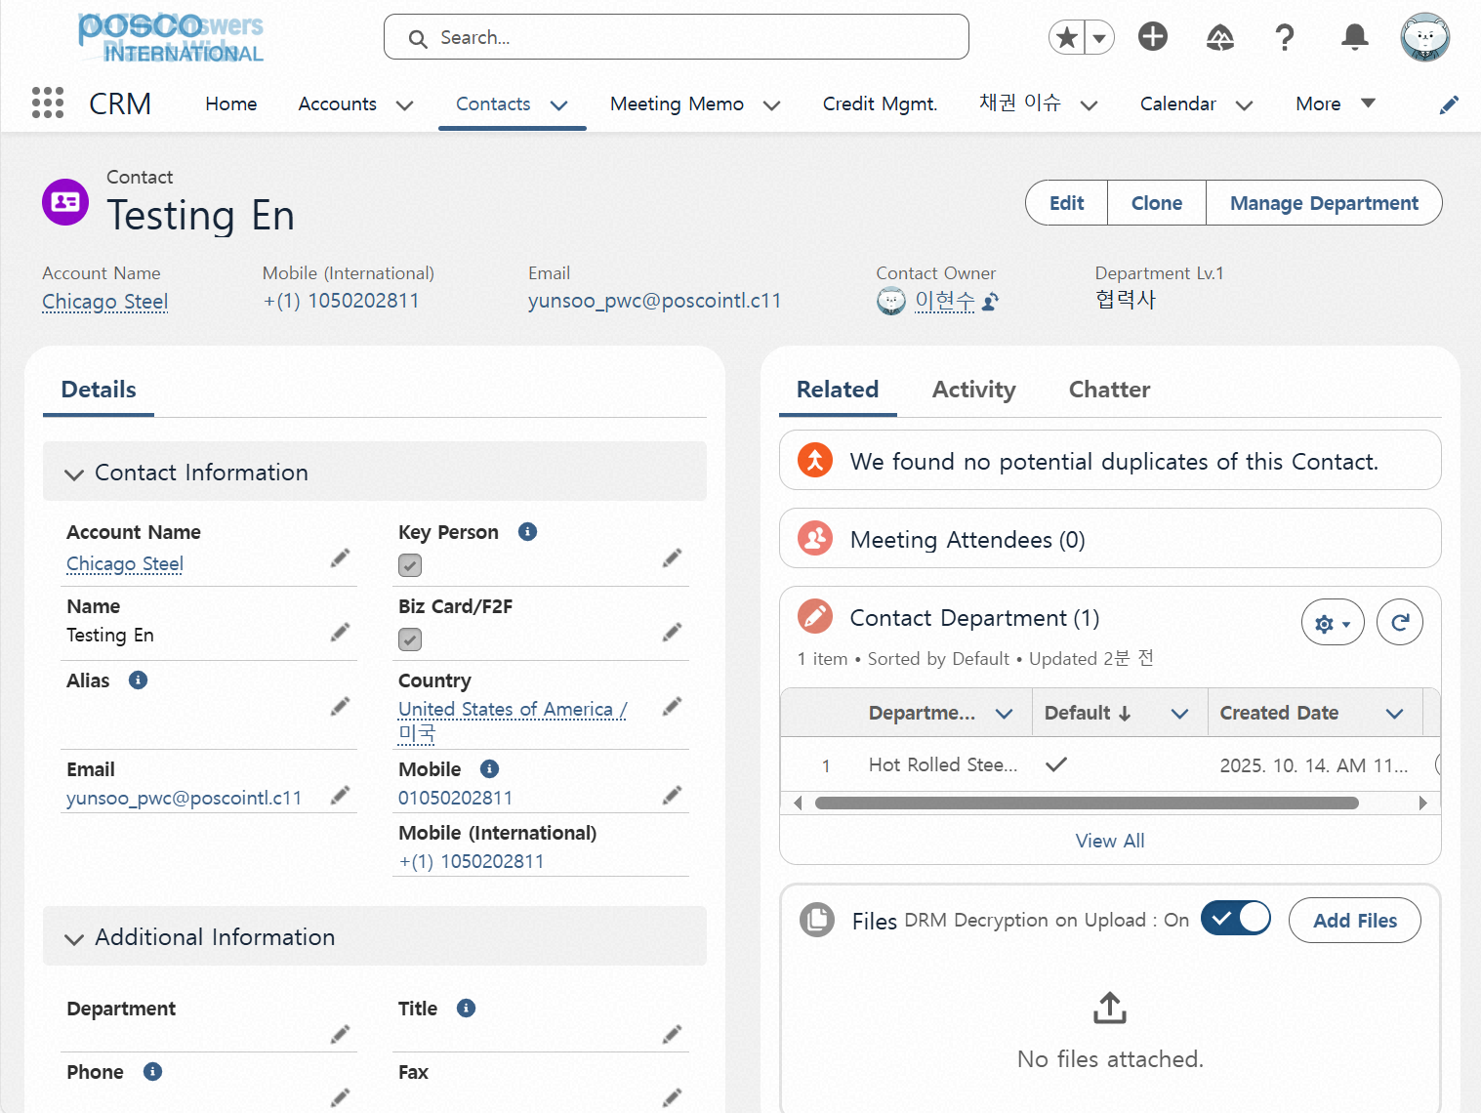
Step 02. Contact Management
Step (Lv.2) | 02.01. Contact View | Step (Lv.3) | 02.01.02 View detailed contact information
Menu | Contact
Navigation | CRM App > Contact > Contact List > Contact Detail View
Contact Detail Area - Displays key information such as Account name, mobile phone number, and email. (*For the “Department” field in Additional Information: if the contact is linked to the Account’s organizational chart, the department will be updated to match the mapped department in the chart. Department info can be modified within the organizational chart.)
Related Meeting Notes Display Area - Shows a list of meeting notes in which the contact participated.
Responsible Organization Display Area - Displays the organization responsible for the contact, which has permission to edit the contact information.
File Upload Area Based on Contact - Files can be uploaded with an option to select whether decryption is required.
1
2
3
4

Slide 25
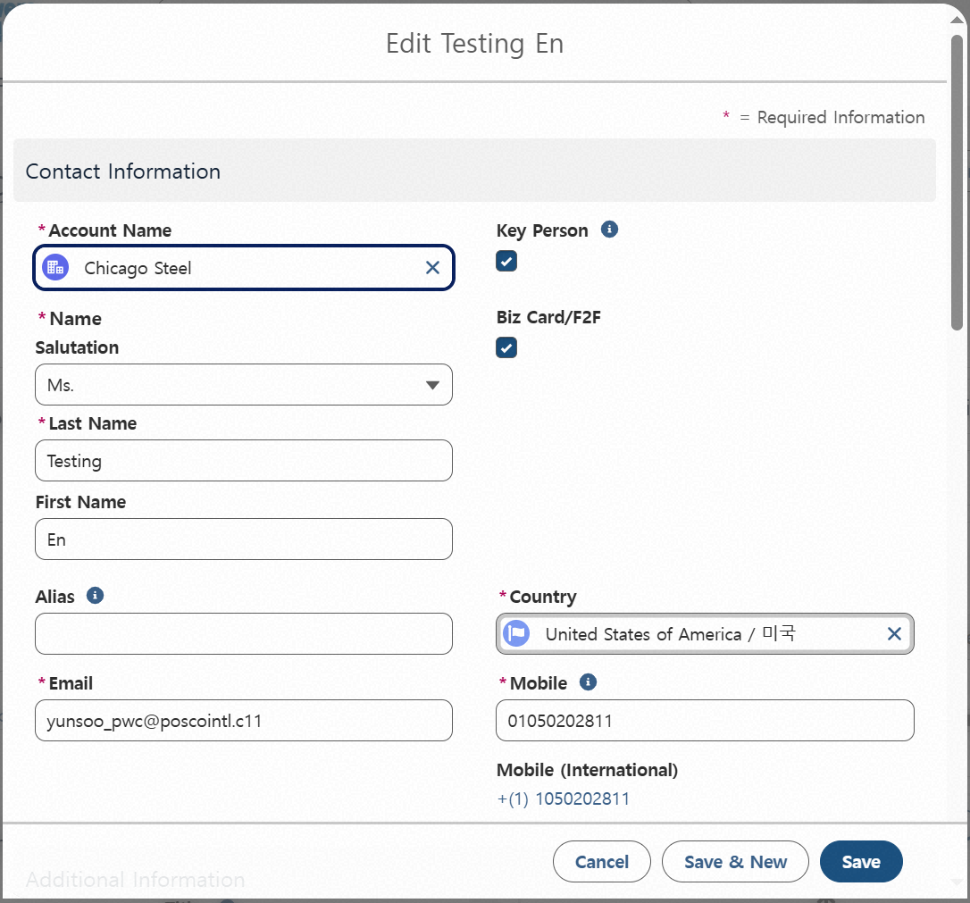
Step 02. Contact Management
Step (Lv.2) | 02.02. Contact Update | Step (Lv.3) | 02.02.01 Update contact information(1/3)
Menu | Contact
Navigation | CRM App > Contact > Contact List > Contact Detail View
Click “Edit” - Opens a popup that allows editing of the contact. - Only fields that are editable can be modified. (*You can also edit fields like contact information by clicking the pencil icon next to each field.)
Click “Save” After Filling Out the Edit Popup - When saved, the contact information will be updated.
1
2

Slide 26
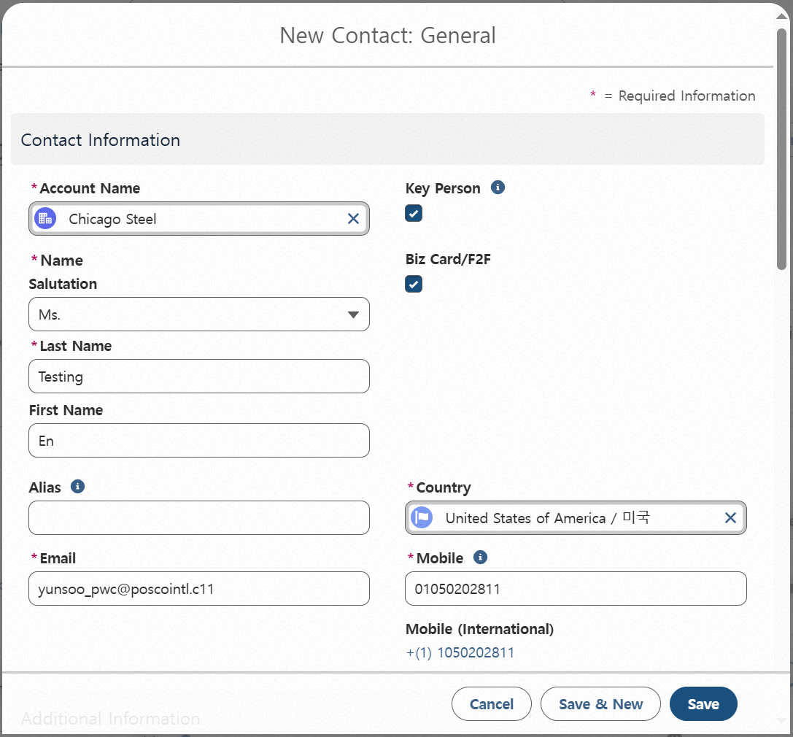
Step 02. Contact Management
Step (Lv.2) | 02.02. Contact Update | Step (Lv.3) | 02.02.01 Update contact information(2/3)
Menu | Contact
Navigation | CRM App > Contact > Contact List > Contact Detail View
Click “Duplicate” - Opens a popup to create a new contact with the same information as the currently viewed contact.
Click “Save” After Filling Out the Form - Saves the entry as a new contact and navigates to the newly saved contact screen. - During saving, duplication is checked, so make sure the entered contact information is different from existing records.
1
2

Slide 27
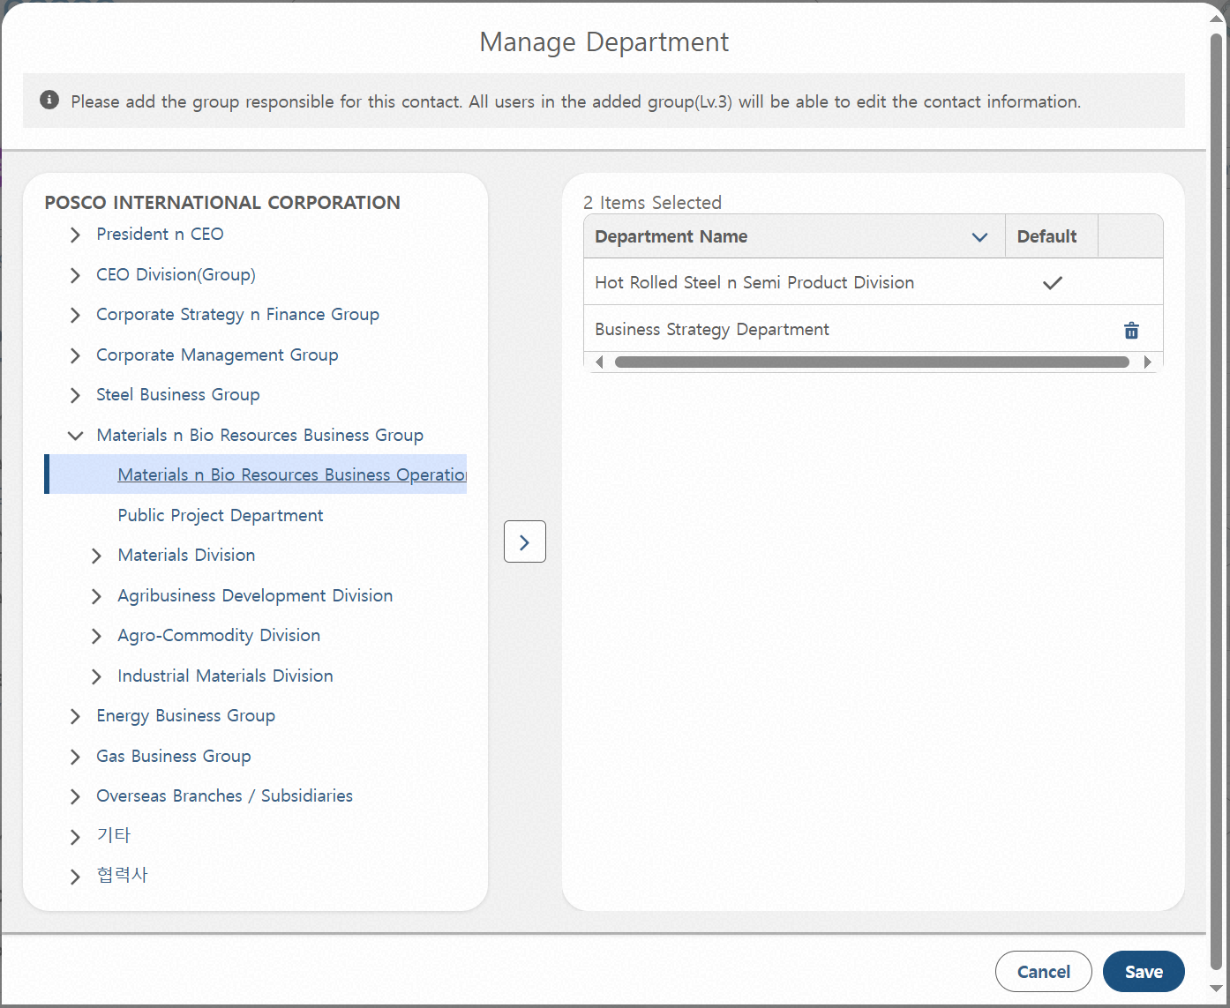
Step 02. Contact Management
Step (Lv.2) | 02.02. Contact Update | Step (Lv.3) | 02.02.01 Update contact information(3/3)
Menu | Contact
Navigation | CRM App > Contact > Contact List > Contact Detail View
Click “Manage Department” - Opens a popup where responsible departments can be added or removed. - This button is only visible to the owner of the contact or the responsible organization.
Click the Right Arrow After Selecting a Department - The selected Department will be set as the responsible Department for the contact and will have permission to edit the contact. - By default, group-level Departments can be added, and direct group/section under headquarters or direct section under a division can also be added.
Click the Delete Icon - Removes the selected Department from the editable list.
Click “Save” - Applies the responsible Department settings.
1
3
2
4

Slide 28
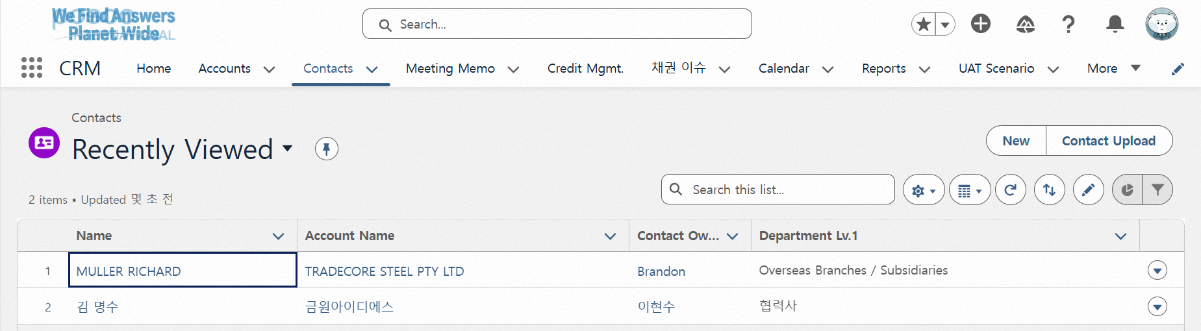
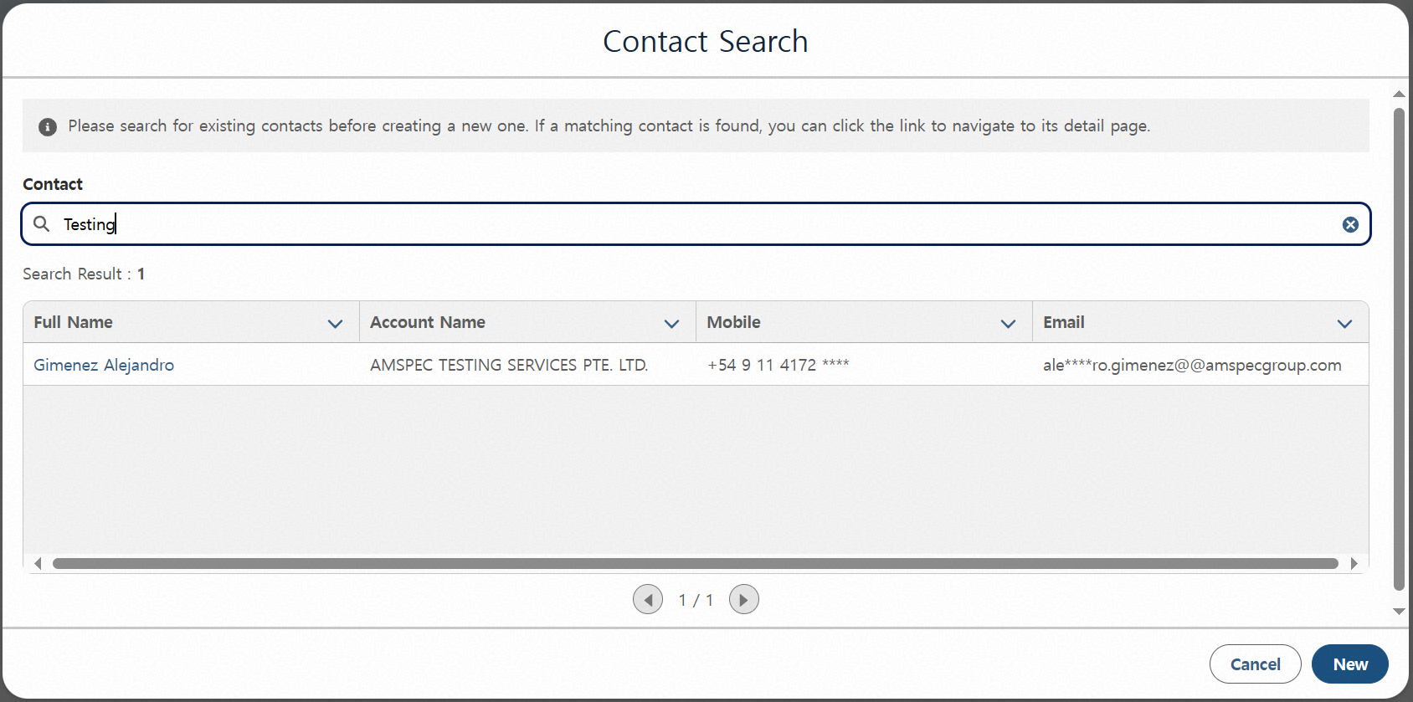
Step 02. Contact Management
Step (Lv.2) | 02.03. Contact Creation | Step (Lv.3) | 02.03.01 Create a single contact (1/3)
Menu | Contact
Navigation | CRM App > Contact > Contact List > New Create Pop-up
Click “New” - Opens the contact creation window. You can check existing records through search.
Name-Based Search Result Area - Allows initial judgment on whether duplicate contacts exist based on the entered name.
Search Result List Provided - Displays information to help determine duplication. - Duplication criteria: Same Account–Name–Email combination or Same Account–Name–Phone Number combination
Click “New” Within the Popup - Transitions to the next popup. In the next popup, you can enter detailed contact information.
1
2
3
4

Slide 29
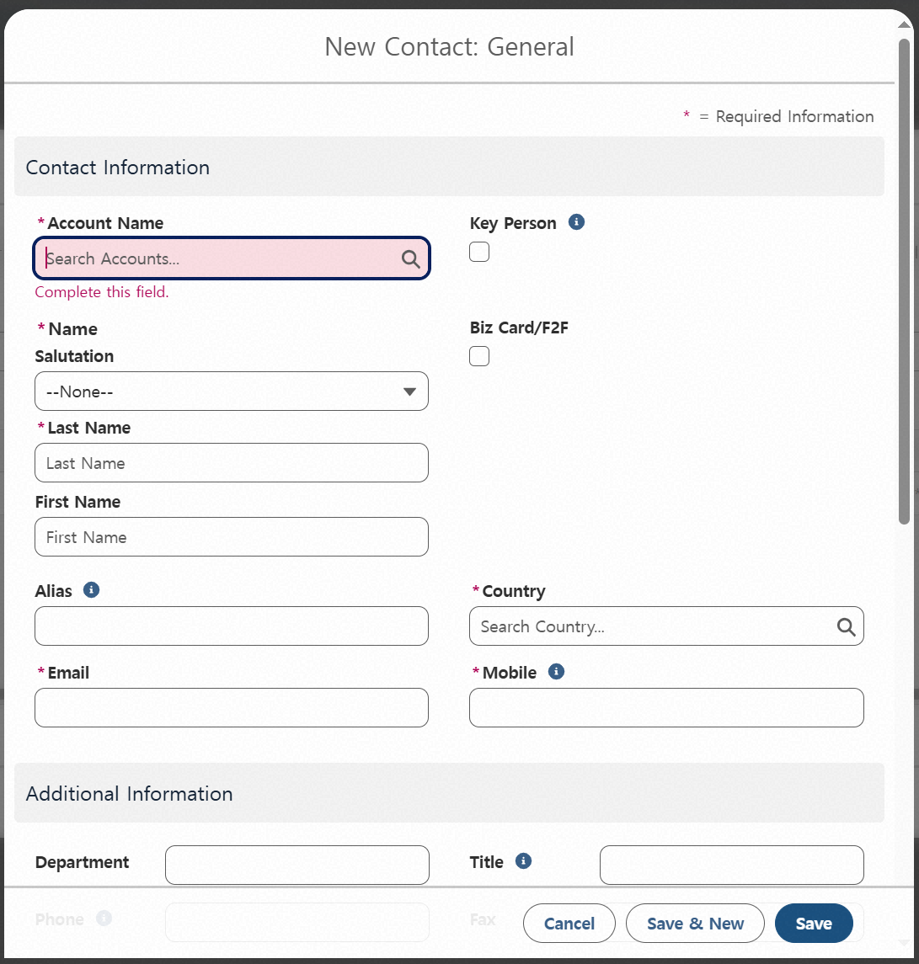
Step 02. Contact Management
Step (Lv.2) | 02.03. Contact Creation | Step (Lv.3) | 02.03.01 Create a single contact (2/3)
Menu | Contact
Navigation | CRM App > Contact > Contact List > New Create Pop-up
Enter the Account Linked to the Contact - Search by name to select an Account. If no results are found, register a new Account.
Enter Name - Enter the last name and first name separately. - For domestic contacts, use Korean. - For overseas contacts, use English.
Enter Alias - Examples include: English name for Korean contacts, Korean name for foreign contacts, or names based on the local language.
Mark as Key Person - If checked, the contact will appear at the top of the contact list in the Account detail screen.
Check Business Card / Face-to-Face Status - If checked, the contact will be visible to all users within the same access group. - If unchecked, the contact will only be visible to the creator’s assigned group.
Enter Country / Phone Number - Selecting a country automatically applies the country code, so manual entry is not required.
4
1
2
5
6
3

Slide 30
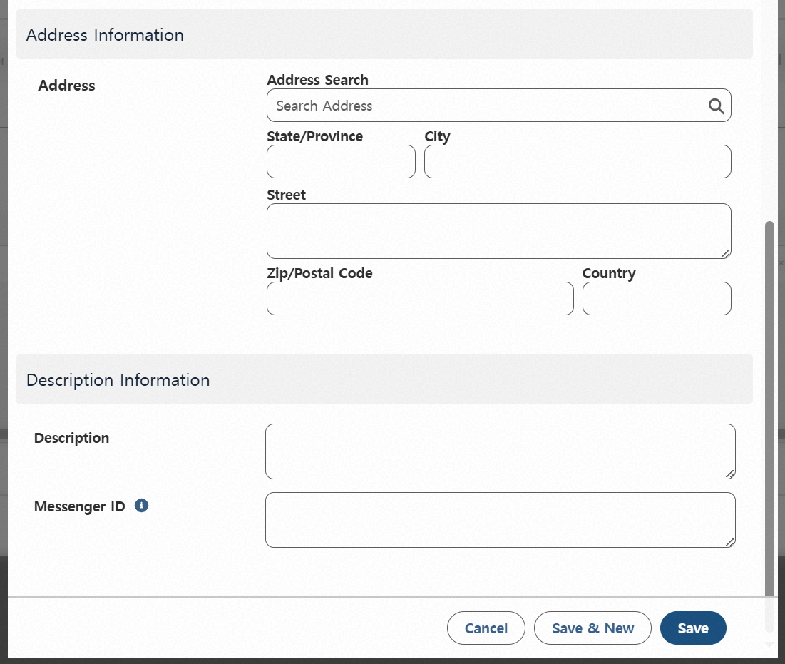
Step 02. Contact Management
Step (Lv.2) | 02.03. Contact Creation | Step (Lv.3) | 02.03.01 Create a single contact (3/3)
Menu | Contact
Navigation | CRM App > Contact > Contact List > New Create Pop-up
Search Address - When an address is selected through search, it is automatically filled in.
Edit Address Information - You can manually enter address information without using search, and you can also modify auto-filled data from search.
Enter Additional Description - Add supplementary notes or comments.
Messenger ID Entry Area - Enter the contact’s messenger ID information. - Example format: Messenger Type: Messenger ID
Click “Cancel” - Returns to the previous popup.
Click “Save and New” - Saves the current entry and reopens the popup.
Click “Save” - Closes the popup and navigates to the contact detail screen. (* Once saved, a summary will be displayed on the home screen.)
1
2
3
4
5
6
7

Slide 31
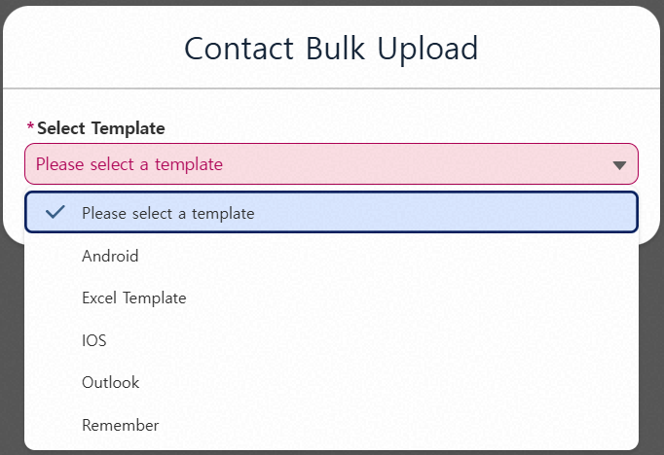
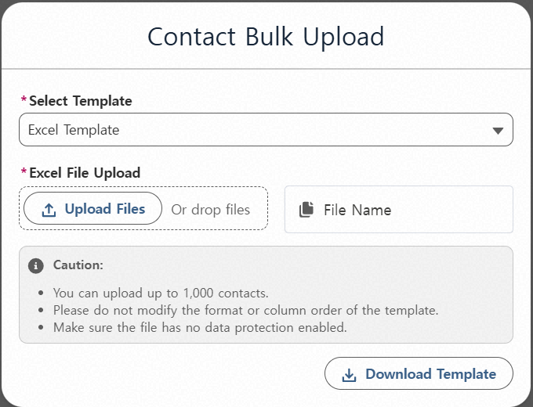
Step 02. Contact Management
Step (Lv.2) | 02.03. Contact Creation | Step (Lv.3) | 02.03.02 Create multiple contact
Menu | Contact |  | Excel Form (1/2)
Navigation | CRM App > Contact > Contact List > Excel Upload Pop-up
Click “Upload Contact” - Opens the contact upload popup.
Select Template - Choose a contact template to proceed. - Based on mobile contacts: Android, iOS - Based on business card apps: Remember - Based on email address book: Outlook - Based on Excel: Excel Template (*Refer to the guide slides for each contact extraction method.)
Click “Download Template” Download the Excel file and enter contact information according to the format.
Upload Completed Contact Excel File Once the upload is complete, an upload button will appear at the bottom.
1
2
4
3

Slide 32
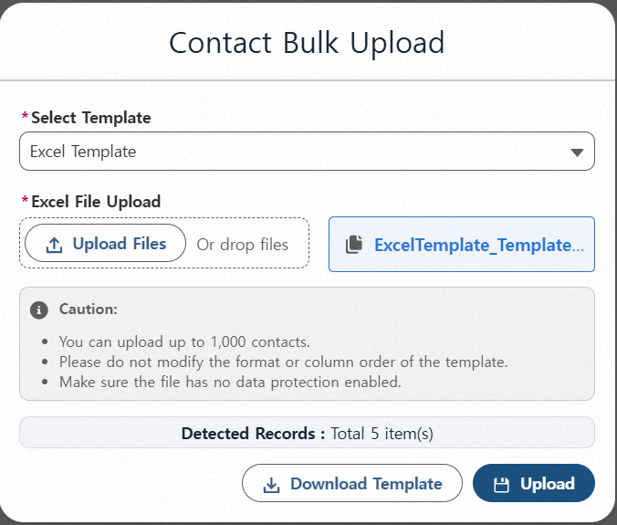
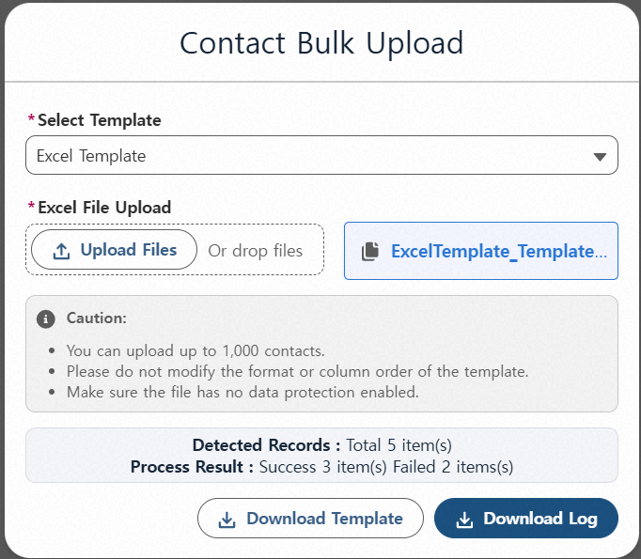
Step 02. Contact Management
Step (Lv.2) | 02.03. Contact Creation | Step (Lv.3) | 02.03.02 Create multiple contact
Menu | Contact |  | Excel Form (2/2)
Navigation | CRM App > Contact > Contact List > Excel Upload Pop-up
Display Uploaded Excel Data - When clicking Upload, the system checks for missing required fields in both the registered contacts and the Excel data.
Click “Upload” - Saves the contacts to Salesforce. Account information is not included. (*Mapping must be performed using the Unmapped Account List.)
Click “Download Result” - Allows you to download the upload result as an Excel file. - You can check upload failures and reasons in columns I and J of the downloaded Excel. - After modifying the content in the “Upload” sheet of the Excel file, you can re-upload the same file.
1
2
3

Slide 33
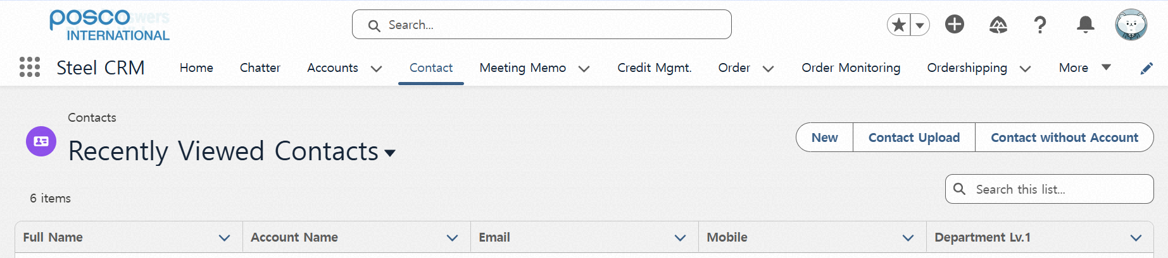
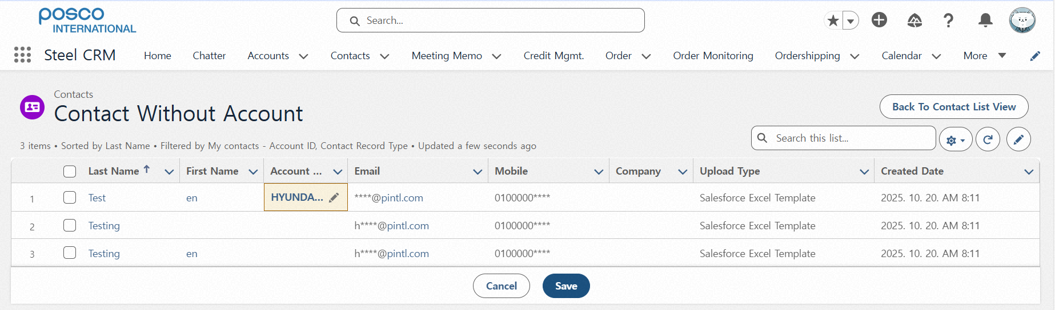
Step 02. Contact Management
Step (Lv.2) | 02.03. Contact Creation | Step (Lv.3) | 02.03.02 Create multiple contact
Menu | Contact |  | Mapping Accounts
Navigation | CRM App > Contact > Contact List > Contact Without Account Pop-up
Click the Account Name Field - Opens the Account search window. - Allows entry of Account information per row.
Click “Save” - Saves the changes made in the list. - By selecting rows using checkboxes, you can assign the same client to all selected rows at once
1
2

Slide 34
Contents_Mobile
Step 1
Account Management
Account View 1. View list of accounts 2. View detailed account information
Account Update 1. Update account information 2. Create Account Card 3. Manage account organization chart
Account Creation 1. Create an account not linked to BP 2. Convert to a BP-linked account

Slide 35
Contents_Mobile
Step 2
Contact Management
Contact View 1. View contact list 2. View detailed contact information
Contact Update 1. Update contact information
Contact Creation 1. Create a single contact 2. Create multiple contacts

Slide 36
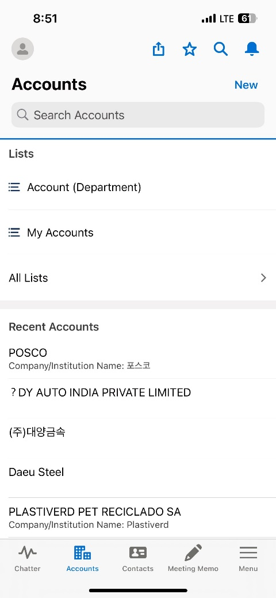
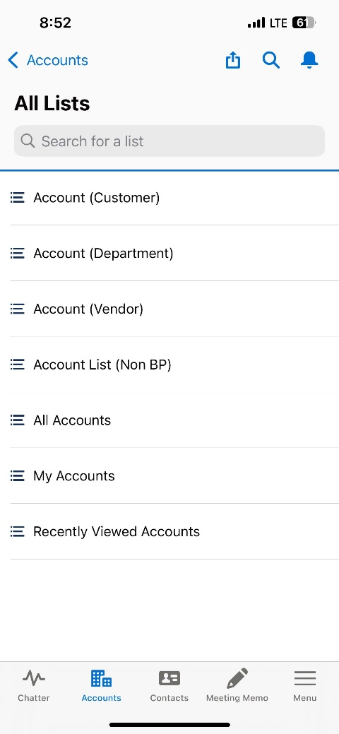
Step 01. Account Management
Step (Lv.2) | 01.01. Account View | Step (Lv.3) | 01.01.01 View list of accounts
Menu | Account
Navigation | CRM App > Account > Account List
Click “Account List” - When clicked, a list of accounts is displayed based on the selected search criteria.
List View Types - My Accounts: Accounts created by the user - All Accounts: All registered accounts - Recently Searched Items: Accounts recently searched (Unsortable) - Recently Viewed Accounts: Accounts recently viewed (Sortable) - Account (Customer): Accounts categorized as Customer type - Account (Vendor): Accounts categorized as Vendor type - Account (Department): Accounts managed based on the user's organization - Account (Non BP): Accounts not yet linked to a Business Partner (BP)
2
1

Slide 37
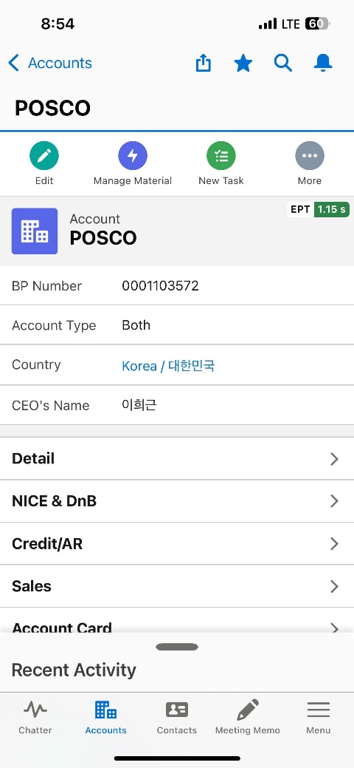
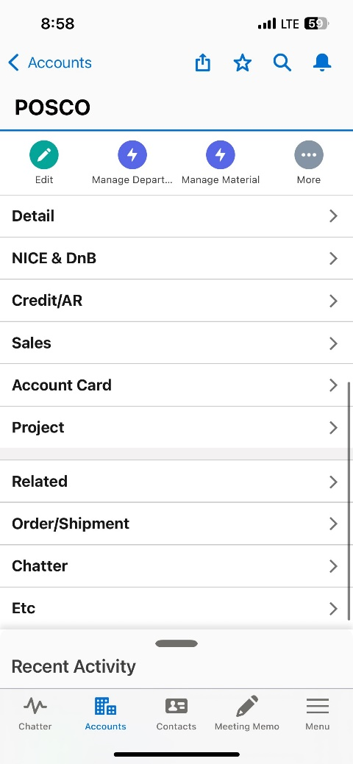
Step 01. Account Management
Step (Lv.2) | 01.01. Account View | Step (Lv.3) | 01.01.02 View detailed account information
Menu | Account
Navigation | CRM App > Account > Account List > Account Details View
Top Key Information Area Displays key Account information at the top of the screen.
View Detailed Information by Tab - Detail Tab: Shows company basic information, SAP integration details, and Nice D&B data. - Credit/AR Tab: Displays credit and receivables information based on the Account. - Sales Tab: Shows sales data based on the Account. - Account Card Tab: Allows document creation and information entry based on Account details. - Project Tab: Displays information on projects and long-term contracts linked to the account. - Related Tab: Displays linked contacts, meeting notes, and gift information. - Order/Shipment Tab: Shows Order and Shipment data per Account. - Chatter Tab: Bulletin board for Account-related discussions. - ETC Tab: Displays additional information such as handled items and responsible organizations.
2
1

Slide 38
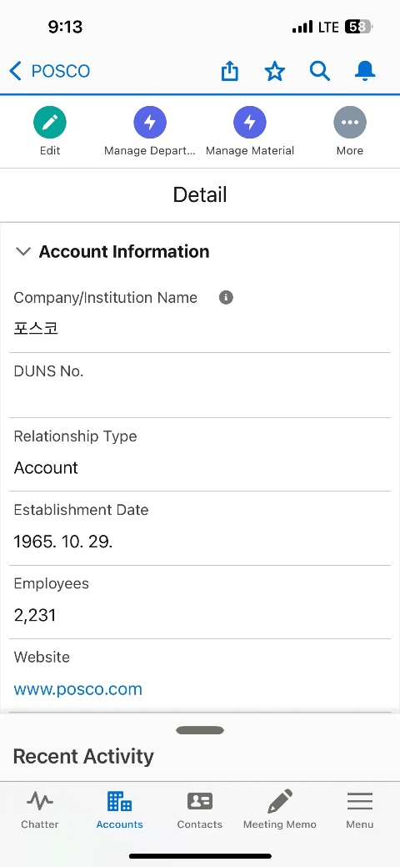
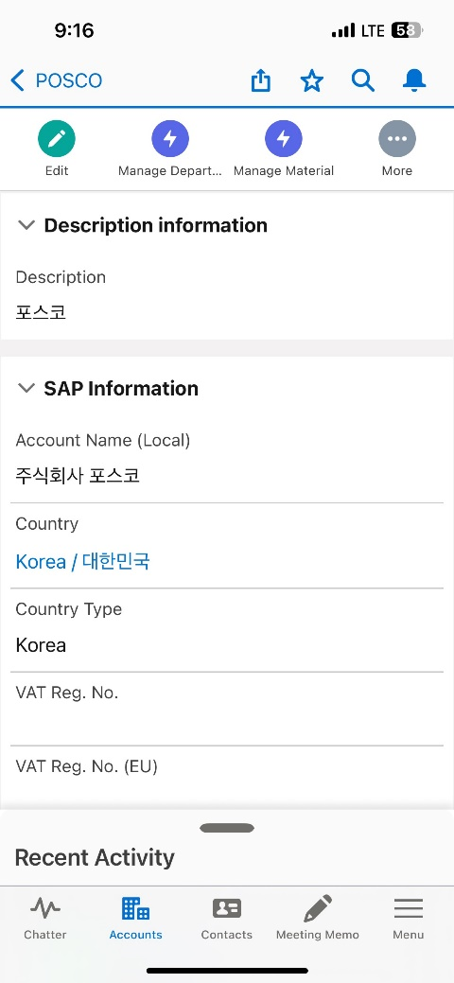
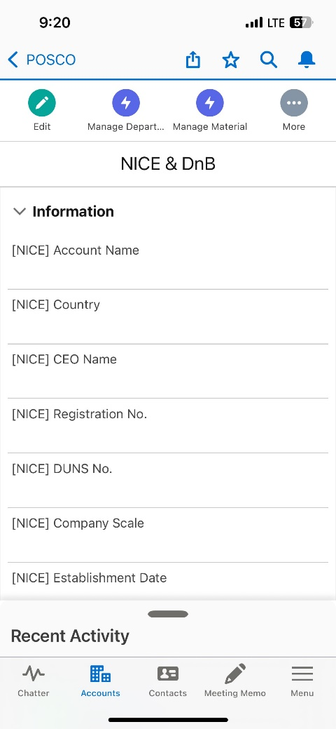
Step 01. Account Management
Step (Lv.2) | 01.01. Account View | Step (Lv.3) | 01.01.02 View detailed account information
Menu | Account |  | (General Information)
Navigation | CRM App > Account > Account List > Account Details View
Account Information Section - This section contains the most basic and essential information about the account. - Most fields in this section are mandatory.
Description Section - This area displays a text-based description of the company.
SAP I/F Information - Shows data retrieved from the SAP system during integration. - This information is read-only and cannot be edited in Salesforce.
NiceD&B Information Tab - When clicked, this tab displays company data integrated from NiceD&B. - Users can view a company overview and financial information for the past three years. - This information is also read-only and cannot be modified.
1
2
4
3

Slide 39
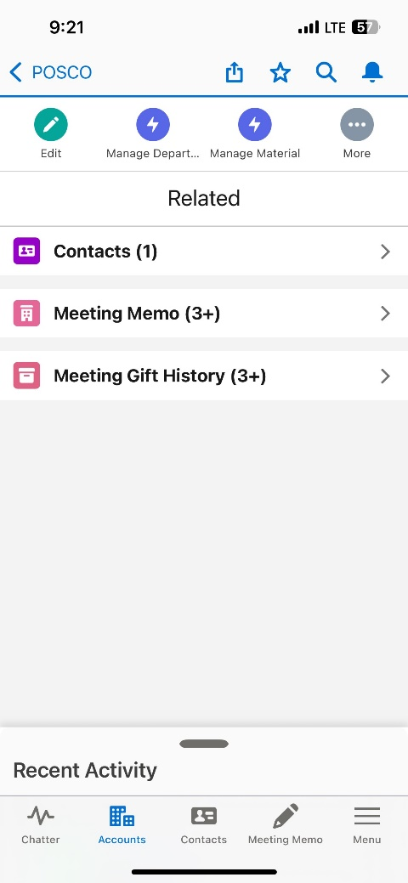
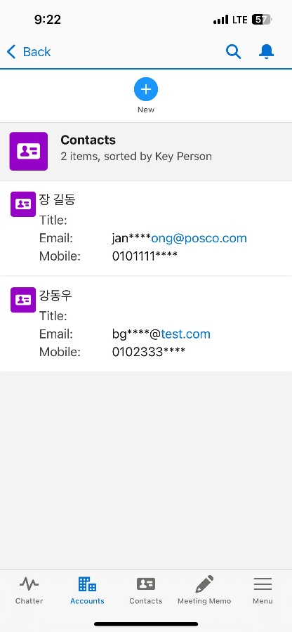
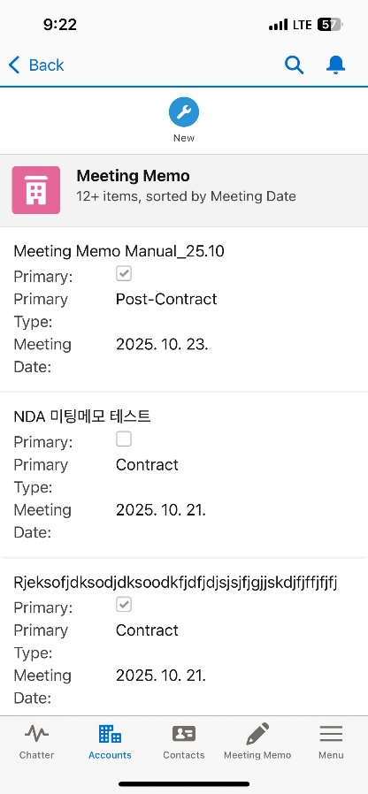

Step 01. Account Management
Step (Lv.2) | 01.01. Account View | Step (Lv.3) | 01.01.02 View detailed account information
Menu | Account |  | (Related)
Navigation | CRM App > Account > Account List > Account Details View
Connected Contacts List - Displays name, job title, mobile phone number, email, and marks key contacts. - Clicking the “New” button allows you to add a new contact.
Connected Meeting Notes List - Shows meeting note title, key account status, type, meeting date, department that created it, and summary information. - Clicking the “New” button allows you to create a new meeting note.
Meeting Gift History List - Displays the list of “Meeting Gift History” recorded in the connected meeting notes. - Shows recipient, gift name, and meeting date.
1
2
3

Slide 40

Step 01. Account Management
Step (Lv.2) | 01.01. Account View | Step (Lv.3) | 01.01.02 View detailed account information
Menu | Account |  | (Credit/ A/R)
Navigation | CRM App > Account > Account List > Account Details View
Credit Information Section - Displays credit information of business partners based on the corporation the user belongs to. - Clicking “View Details” switches to the Credit Monitoring Dashboard screen.
1

Slide 41


Step 01. Account Management
Step (Lv.2) | 01.01. Account View | Step (Lv.3) | 01.01.02 View detailed account information
Menu | Account |  | (Order/Shipment)
Navigation | CRM App > Account > Account List > Account Details View
Shipment Status Information Section - Displays shipment information of business partners based on the organization the user belongs to (Only Steel Division). - Clicking “Details” switches to the Order/Shipment Monitoring Dashboard screen.
Order Information Section - A list of order information linked to the related Account.
1
2

Slide 42



Step 01. Account Management
Step (Lv.2) | 01.01. Account View | Step (Lv.3) | 01.01.02 View detailed account information
Menu | Account |  | (Sales)
Navigation | CRM App > Account > Account List > Account Details View
거래선별 매출 영역 - 연단위의 매출, 매출총익, 세전이익 조회됨 (총 3개년 표기)
금액 표기 통화/단위 선택 필터 - KRW (원/백만원), USD(달러/천달러) 총 4개의 통화별 단위 제공
조직 선택 필터 - 실장 이상 직급 혹은 주무의 경우에 소속 실/본부이하의 조직 기준으로 매출 조회 가능
거래선의 품목별 매출 영역 - 품목 단위의 연간 매출이 표기됨 - 수량/매출/이익이 품목단위로 노출
매출 조회 기준은 SAP Billing 기준 - Sold-To, Ship-To로 각각 조회 가능
Sales Data Reference Standard - Based on SAP Billing. - Can be viewed by both Sold-To and Ship-To.
Currency/Unit Selection Filter for Amount Display - Provides 4 options: KRW (Won / million Won), USD (Dollar / thousand Dollar).
Organization Selection Filter - For users with department head level or key roles, sales data can be viewed based on their affiliated department/division.
Sales by Account - Displays annual sales, gross profit, and pre-tax profit (shown for the past 3 years).
Sales by Item per Account - Displays annual sales by item. - Quantity, sales, and profit are shown per item.
5
1
2
3
4

Slide 43



Step 01. Account Management
Step (Lv.2) | 01.01. Account View | Step (Lv.3) | 01.01.02 View detailed account information
Menu | Account |  | (Project)
Navigation | CRM App > Account > Account List > Account Details View
Contract/Project Management Section - To be filled out when there is a long-term contract or project-based transaction with the Account. - Can only be modified or deleted if created by your own organization. - Can be created regardless of the Account’s managing organization, and can be mapped to order information via the Order Dashboard (Only Steel Division).
Contract/Project Creation Popup - Duplicate Creation with the same contract/project name is not allowed.
1
+
2

Slide 44


Step 01. Account Management
Step (Lv.2) | 01.01. Account View | Step (Lv.3) | 01.01.02 View detailed account information
Menu | Account |  | (Timeline)
Navigation | CRM App > Account > Account List > Account Details View
When Clicking “New Event” - Allows you to create a schedule related to the account.
When Clicking “New Task” - Allows you to create a to-do item related to the account.
Timeline History Section - Includes a TO-DO List area showing registered tasks and upcoming events, and a History area showing past events.
3
Activity history
1
2

Slide 45

Step 01. Account Management
Step (Lv.2) | 01.01. Account View | Step (Lv.3) | 01.01.02 View detailed account information
Menu | Account |  | (Chatter)
Navigation | CRM App > Account > Account List > Account Details View
Post Creation Section - Allows users to write work-related posts or questions based on the account. - All created posts are visible to everyone.
Sorting and Searching Created Posts - Posts can be sorted and searched.
Created Posts - Posts are displayed in reverse chronological order by default, and all posts allow comments.
Created Events/Tasks - When an event or task is created, it appears in the chatter feed similar to a post, and comments can be added.
1
2

Slide 46

Step 01. Account Management
Step (Lv.2) | 01.01. Account View | Step (Lv.3) | 01.01.02 View detailed account information
Menu | Account |  | (Etc. Information)
Navigation | CRM App > Account > Account List > Account Details View
Responsible Organization Display Section for the Account - Shows the organization that has permission to edit the account information.
Company Code Information Display Section - If the account is linked as a BP or extended to an overseas entity, the relevant corporate information is shown.
Exposed Items Handled by the Organization - Items that can be added based on the responsible organization. - Follows the Material Group standard in SAP.
Account Modification History Section - Displays the history of changes made to the account.
1
2
3
4

Slide 47


Step 01. Account Management
Step (Lv.2) | 01.02. Account Update | Step (Lv.3) | 01.02.01 Update account information(1/2)
Menu | Account
Navigation | CRM App > Account > Account List > Account Details View
When Clicking the “Edit” Button - Opens a popup that allows editing of the account. - Only editable data fields can be modified. (* Fields like basic information can also be edited by clicking the pencil icon.)
After Filling Out the Edit Popup, Click “Save” - Upon saving, the account information is updated. - Duplicate checks are performed during editing as well (e.g., when modifying business registration number or VAT ID).
2
1

Slide 48


Step 01. Account Management
Step (Lv.2) | 01.02. Account Update | Step (Lv.3) | 01.02.01 Update account information(2/2)
Menu | Account
Navigation | CRM App > Account > Account List > Account Details View
When Clicking the “Manage Responsible Organization” Button - Opens a popup where responsible organizations can be added or removed. - This button is only visible to the owner of the account and its responsible organizations.
After Selecting an Organization, Click the Right Arrow - Adds the selected organization (from the left) as a responsible organization for the account. - The added organization gains editing permissions. - By default, group-level organizations can be added, and direct groups/sections under the division or department can also be added.
Clicking the Delete Icon - Removes the selected organization from the editable list.
Clicking “Save” - Applies the changes made to the responsible organization settings.
1
2
3
4

Slide 49

Step 01. Account Management
Step (Lv.2) | 01.02. Account Update | Step (Lv.3) | 01.02.02 Create Account Card
Menu | Account
Navigation | CRM App > Account > Account List > Account Details View
“고객사 카드 미리보기” 클릭 - 거래선의 기본정보와 하단에 작성된 카드정보 기준으로 고객사 카드 문서의 미리보기 팝업 생성 - 미리보기 팝업 상에서 PDF, DOC 파일로 다운로드 가능
카드 정보 작성 영역 - 설명 정보의 입력 란으로 텍스트와 이미지의 붙여넣기가 가능함
다운로드 이력 영역 - 과거 생성된 고객사 카드의 이력을 확인 할 수 있으며, 본인 조직(그룹)의 다운로드 이력만 다운로드 가능
Account Card Information Viewing Section - Displays the customer description information that has been entered. (* Creation is not supported due to solution limitations.) (** File download is not available due to security restrictions.)
1

Slide 50


Step 01. Account Management
Step (Lv.2) | 01.03. Account Creation | Step (Lv.3) | 01.03.01 Create an account not linked to BP
Menu | Account |  | (1/3)
Navigation | CRM App > Account > Account List > New Create Pop-up
Click “New” - Opens a popup to create a new Account. You can check existing records through search.
Search Account Information Based on External Data - Provides popups for Nice BizLine and Hoovers to pre-search company information.
Account Name-Based Search Result Area - Allows initial judgment on duplicate Accounts based on the Account name.
Search Result List Provided - Displays information to help determine duplication. - Criteria for duplication: Business Registration Number VAT Identification Number
Click “New” - When clicked, transitions to the next popup. - In the next popup, you can enter detailed Account information.
1
2
3
4
5

Slide 51


Step 01. Account Management
Step (Lv.2) | 01.03. Account Creation | Step (Lv.3) | 01.03.01 Create an account not linked to BP
Menu | Account |  | (2/3)
Navigation | CRM App > Account > Account List > New Create Pop-up
Select Country Classification - Choose between Domestic or Overseas - Domestic: Business Registration Number is required - Overseas: VAT ID is required (DUNS Number is provided as an optional)
Select Relationship Type - Choose one of the following: Account, Partner, or Government Relations - If Account is selected, additional selection of Account Type is required
Select Country Type - For Domestic, South Korea is automatically set - For Overseas, search and select the country manually
Select Account Type - Choose one: Customer, Vendor, or Both - If Customer is selected, Tax Type selection is required
3
4
1
2

Slide 52


Step 01. Account Management
Step (Lv.2) | 01.03. Account Creation | Step (Lv.3) | 01.03.01 Create an account not linked to BP
Menu | Account |  | (3/3)
Navigation | CRM App > Account > Account List > New Create Pop-up
Enter Additional Information - This area is for entering supplementary information for management purposes.
Enter Description Text for the Account - Write descriptive information about the Account.
Address Information - Address data will be linked when converting to SAP BP later.
Click “Cancel” - Returns to the previous popup.
Click “Save” - Checks for duplicates before saving. After saving, navigates to the screen of the newly created Account. (* Once saved, a summary will be displayed on the home screen.)
1
4
5
2
3

Slide 53



Step 02. Contact Management
Step (Lv.2) | 02.01. Contact View | Step (Lv.3) | 02.01.01 View contact list
Menu | Contact
Navigation | CRM App > Contact > Contact List
Click “Contact List” - When clicked, a list of contacts is displayed based on the selected search criteria.
Search Conditions by List View - My Contacts: Contacts created by the user - Recently Searched Items: Contacts recently searched (unsortable / latest first) - Recently Viewed Contacts: Contacts recently viewed (sortable) - Contact without Account: Contacts uploaded via “Contact Upload” that are not mapped to any Account - Contact (Department): Contacts managed based on the user’s organization
Contact Access Permissions Are Based on the Following Groups:
1) Steel Division, Materials & Bio Division, Overseas Division 2) Gas Business Division, Energy Business Division
3) Corporate Support, Corporate Planning, Partners, Others
(* According to company’s internal Privacy Policy, email addresses and mobile phone numbers are masked in the list view.)
2
1

Slide 54



Step 02. Contact Management
Step (Lv.2) | 02.01. Contact View | Step (Lv.3) | 02.01.02 View detailed contact information
Menu | Contact
Navigation | CRM App > Contact > Contact List > Contact Detail View
Contact Detail Area - Displays key information such as Account name, mobile phone number, and email.
Related Meeting Notes Display Area - Shows a list of meeting notes in which the contact participated.
Responsible Organization Display Area - Displays the organization responsible for the contact, which has permission to edit the contact information.
File Upload Area Based on Contact - Files can be uploaded with an option to select whether decryption is required.
3
1
2

Slide 55

Step 02. Contact Management
Step (Lv.2) | 02.02. Contact Update | Step (Lv.3) | 02.02.01 Update contact information(1/3)
Menu | Contact
Navigation | CRM App > Contact > Contact List > Contact Detail View
Click “Edit” - Opens a popup that allows editing of the contact. - Only fields that are editable can be modified. (*You can also edit fields like contact information by clicking the pencil icon next to each field.)
Click “Save” After Filling Out the Edit Popup - When saved, the contact information will be updated.
2
1

Slide 56
Step 02. Contact Management
Step (Lv.2) | 02.02. Contact Update | Step (Lv.3) | 02.02.01 Update contact information(2/3)
Menu | Contact
Navigation | CRM App > Contact > Contact List > Contact Detail View
Click “Duplicate” - Opens a popup to create a new contact with the same information as the currently viewed contact.
Click “Save” After Filling Out the Form - Saves the entry as a new contact and navigates to the newly saved contact screen. - During saving, duplication is checked, so make sure the entered contact information is different from existing records.
2
1

Slide 57

Step 02. Contact Management
Step (Lv.2) | 02.02. Contact Update | Step (Lv.3) | 02.02.01 Update contact information(3/3)
Menu | Contact
Navigation | CRM App > Contact > Contact List > Contact Detail View
Click “Manage Responsible Organization” - Opens a popup where responsible organizations can be added or removed. - This button is only visible to the owner of the contact or the responsible organization.
Click the Right Arrow After Selecting an Organization - The selected organization will be set as the responsible organization for the contact and will have permission to edit the contact. - By default, group-level organizations can be added, and direct group/section under headquarters or direct section under a division can also be added.
Click the Delete Icon - Removes the selected organization from the editable list.
Click “Save” - Applies the responsible organization settings.
1
2
3
4

Slide 58

Step 02. Contact Management
Step (Lv.2) | 02.03. Contact Creation | Step (Lv.3) | 02.03.01 Create a single contact (1/3)
Menu | Contact
Navigation | CRM App > Contact > Contact List > New Create Pop-up
Click “New” - Opens the contact creation window. You can check existing records through search.
Name-Based Search Result Area - Allows initial judgment on whether duplicate contacts exist based on the entered name.
Search Result List Provided - Displays information to help determine duplication. - Duplication criteria: Same Account–Name–Email combination Same Account–Name–Phone Number combination
Click “New” Within the Popup - Transitions to the next popup. In the next popup, you can enter detailed contact information.
1
2
3
4

Slide 59


Step 02. Contact Management
Step (Lv.2) | 02.03. Contact Creation | Step (Lv.3) | 02.03.01 Create a single contact (2/3)
Menu | Contact
Navigation | CRM App > Contact > Contact List > New Create Pop-up
Enter the Account Linked to the Contact - Search by name to select an Account. If no results are found, register a new Account.
Enter Name - Enter the last name and first name separately. - For domestic contacts, use Korean. - For overseas contacts, use English.
Enter Alias - Examples include: English name for Korean contacts, Korean name for foreign contacts, or names based on the local language.
Enter Country / Phone Number - Selecting a country automatically applies the country code, so manual entry is not required.
Check Business Card / Face-to-Face Status - If checked, the contact will be visible to all users within the same access group. - If unchecked, the contact will only be visible to the creator’s assigned group.
Mark as Key Person - If checked, the contact will appear at the top of the contact list in the Account View.
5
1
6
2
3
4

Slide 60

Step 02. Contact Management
Step (Lv.2) | 02.03. Contact Creation | Step (Lv.3) | 02.03.01 Create a single contact (3/3)
Menu | Contact
Navigation | CRM App > Contact > Contact List > New Create Pop-up
Search Address - When an address is selected through search, it is automatically filled in.
Edit Address Information - You can manually enter address information without using search, and you can also modify auto-filled data from search.
Enter Additional Description - Add supplementary notes or comments.
Messenger ID Entry Area - Enter the contact’s messenger ID information. - Example format: Messenger Type: Messenger ID
Click “Cancel” - Returns to the previous popup.
Click “Save” - Closes the popup and navigates to the contact detail screen. (* Once saved, a summary will be displayed on the home screen.)
5
6
1
2
3
4

Slide 61


Step 02. Contact Management
Step (Lv.2) | 02.03. Contact Creation | Step (Lv.3) | 02.03.02 Create multiple contact
Menu | Contact |  | Excel Form (1/2)
Navigation | CRM App > Contact > Contact List > Excel Upload Pop-up
Click “Upload Contact” - Opens the contact upload popup.
Select Template - Choose a contact template to proceed. - Based on mobile contacts: Android, iOS - Based on business card apps: Remember - Based on email address book: Outlook - Based on Excel: Excel Template (*Refer to the guide slides for each contact extraction method.)
Click “Download Template” Download the Excel file and enter contact information according to the format.
Upload Completed Contact Excel File Once the upload is complete, an upload button will appear at the bottom.
1
2
4
3

Slide 62


Step 02. Contact Management
Step (Lv.2) | 02.03. Contact Creation | Step (Lv.3) | 02.03.02 Create multiple contact
Menu | Contact |  | Excel Form (2/2)
Navigation | CRM App > Contact > Contact List > Excel Upload Pop-up
Display Uploaded Excel Data - When clicking Upload, the system checks for missing required fields in both the registered contacts and the Excel data.
Click “Upload” - Saves the contacts to Salesforce. Account information is not included. (*Mapping must be performed using the Unmapped Account List.)
Click “Download Result” - Allows you to download the upload result as an Excel file. - You can check upload failures and reasons in columns I and J of the downloaded Excel. - After modifying the content in the “Upload” sheet of the Excel file, you can re-upload the same file.
1
2
3

Slide 63



Step 02. Contact Management
Step (Lv.2) | 02.03. Contact Creation | Step (Lv.3) | 02.03.02 Create multiple contact
Menu | Contact |  | Mapping Accounts
Navigation | CRM App > Contact > Contact List > Contact With Missing Information List
Accessing “Contact without Account”
Click on a contact that does not have associated Account information.
Click the “Edit” button to proceed with adding an Account.
3
2
1

Slide 64
[Appendix] Accounts Permission Settings
Function
Create Access
View Access
Edit Access
Accounts
Create All Users
All Users Can View
All Accounts
Only Assigned Team
Can Edit Account
Sales
Read Only
View Sales Data for Own
and Subordinate Teams
Read Only
Credit/AR
Read Only
View Credit and AR
for Own Company
Read Only
Order/ Shipment
Read Only
Steel Division Only
Read Only
Project
Create All Users
All Users Can View
All Projects
Only Assigned Team
Can Edit Project
NDA Accounts
Create Admin User
Only users
with access permission
can view the account
Only users
with access permission
can Edit Account

Slide 65


[Appendix] Contact Permission Settings
Default Contact View Access
View Access Based on Biz Card / F2F
Contact Edit Access
View Access Granted Based on Separate Organizational Classification
(Changes according to personal data protection review)
View Access Granted for Same Organizational Classification
View Access Granted Only to the Creator’s Organization
Edit Access Granted to
Creator’s Organization (Group)
and Responsible Department
Check
UnCheck
Steel, Materials & Bio,
Overseas Division
Check Biz Card / F2F
Steel, Materials & Bio, Overseas
Group A
Data View Available
Creator
Steel, Materials & Bio, Overseas
Data Edit Restrictions
Gas Business,
Energy Business
Un-Check Biz Card / F2F
Group B
Mutual Data View Restrictions
Group A
Request to add an assigned department
Group C
Creator
Management Support,
Business Planning,
Partners, Others
Data View Restrictions
Other Groups
Group B
Group C
Other Divisions
Access
Addition
Process
Identify the Contact for Access Grant
Request to Add Assigned Department
Re-request Assigned Department
Access is not allowed when only the URL is shared
Request to add your own group as the assigned department
If you only have view access, forward the request to a member of the assigned department.
Creator
Sharing Target
Creator
Owner Team

Slide 66
[Appendix] List of Functions Not Supported on Mobile
Area | Feature | Feature Details | Reason for Mobile Exclusion
Common | File Download | Download files uploaded to Salesforce. | File download is fundamentally restricted by POSCO International security policy.
 | Home Dashboard | Organization-based and personal-based views on the home screen. | Difficult to ensure usability in mobile layout; low demand; requires heavy custom development.
Account & Contact | Customer Card Generation | Generate customer cards (PDF, Word) based on account info; includes history. | File download restricted on mobile; task unsuitable for mobile execution.
 | SAP BP Request | Display SAP BP registration screen for accounts not registered in BP. | SAP BP registration is not supported on mobile.
 | Account Organization Chart | Create and edit organization charts; map contacts. | Task unsuitable for mobile; feature limited to authorized users.
Sales Support | NDA Account Meeting Notes Sharing | Share NDA meeting notes with other team members. | Standard sharing not supported on mobile; available on PC only.
Order & Fulfillment | POSCO Customer Mapping | Select multiple orders for same POSCO customer and map BP. | Mobile UI does not support multi-record selection in List View.
 | Monthly Shipment Report | View monthly shipment volume report by shipment year. | Matrix-type report not supported on mobile; only detailed info viewable.

Slide 67



[Appendix] Download iOS Contacts(1/3)
Step (Lv.2) | 02.03. Contact Creation | Step (Lv.3) | 02.03.02 Create multiple contact
Menu | - |  | iOS Contact(1/3)
Navigation | -
Open the “Contacts” App on iPhone (iOS) Tap the “Add List” button at the top right.
Tap the “iPhone” Option Create a list to export specific contacts.
Tap the Created Contact List, Then Tap “Add Contacts” Add contacts to the newly created list.
If you export all contacts, personal contacts may be included. Please make sure to create a separate group for work-related contacts before exporting.
1
2
3
4

Slide 68




[Appendix] Download iOS Contacts(2/3)
Step (Lv.2) | 02.03. Contact Creation | Step (Lv.3) | 02.03.02 Create multiple contact
Menu | - |  | iOS Contact(2/3)
Navigation | -
Search for Desired Contacts Search and select contacts to add to the export list.
Add to Export List After selecting, add the contacts to the export list.
Click the “List” Button After Adding Contacts Tap the list to proceed with export.
Long Press the Export Contact List From the displayed menu, tap “Export”.
If you export all contacts, personal contacts may be included. Please make sure to create a separate group for work-related contacts before exporting.
1
3
2
5
4

Slide 69


[Appendix] Download iOS Contacts(3/3)
Step (Lv.2) | 02.03. Contact Creation | Step (Lv.3) | 02.03.02 Create multiple contact
Menu | - |  | iOS Contact(3/3)
Navigation | -
Select Fields to Share, Then Click “Done” - The fields shown may vary depending on the contact information.
Save the Generated Contact File (.vcf) You can either save the file to your phone or select an email app to send it to yourself, then download it on your desktop.
If you export all contacts, personal contacts may be included. Please make sure to create a separate group for work-related contacts before exporting.
1
2

Slide 70



[Appendix] Download AOS Contacts(1/3)
Step (Lv.2) | 02.03. Contact Creation | Step (Lv.3) | 02.03.02 Create multiple contact
Menu | - |  | AOS Contact(1/3)
Navigation | -
2
Open the “Contacts” App and Tap “Groups”
Tap the “+” button at the top right of the screen.
Enter Group Name For example: Work Contacts for Export.
Tap “Add Members to Group” Add contacts to the newly created group.
If you export all contacts, personal contacts may be included. Please make sure to create a separate group for work-related contacts before exporting.
3
4
1

Slide 71



[Appendix] Download AOS Contacts(2/3)
Step (Lv.2) | 02.03. Contact Creation | Step (Lv.3) | 02.03.02 Create multiple contact
Menu | - |  | AOS Contact(2/3)
Navigation | -
Select Contacts to Add to the Group
Tap the “Done” Button at the Bottom of the Screen
After Verifying the Added Contacts, Tap the “Save” Button at the Bottom Right Saves the group with the selected contacts.
Long Press Any Contact to Activate the Selection List Allows multiple contacts to be selected for further actions.
If you export all contacts, personal contacts may be included. Please make sure to create a separate group for work-related contacts before exporting.
1
4
2
3

Slide 72



[Appendix] Download AOS Contacts(3/3)
Step (Lv.2) | 02.03. Contact Creation | Step (Lv.3) | 02.03.02 Create multiple contact
Menu | - |  | AOS Contact(3/3)
Navigation | -
Select Contacts to Export - Select the desired contacts (select all if needed).
Tap the “Share” Button at the Bottom Left of the Screen
Select Fields to Share, Then Tap “Done” at the Bottom - Name, phone number, and email must be selected. (The fields shown may vary depending on the contact information entered.)
Send the Generated Contact File (.vcf) - Choose your email app and send the file to yourself. - Download it on your desktop or mobile device.
If you export all contacts, personal contacts may be included. Please make sure to create a separate group for work-related contacts before exporting.
Note: On Android devices, saving contact files directly to the phone is not supported. You must send the file to your email and download it from there.
3
1
4
2

Slide 73


[Appendix] Download Remember Contacts(1/2)
Step (Lv.2) | 02.03. Contact Creation | Step (Lv.3) | 02.03.02 Create multiple contact
Menu | - |  | Remember(1/2)
Navigation | -
Open the Remember App and Tap “My Profile” at the Bottom
Tap the menu icon at the top right.
Tap the Settings Button at the Top Opens the settings screen.
2
3
1

Slide 74


[Appendix] Download Remember Contacts(2/2)
Step (Lv.2) | 02.03. Contact Creation | Step (Lv.3) | 02.03.02 Create multiple contact
Menu | - |  | Remember(2/2)
Navigation | -
Click the “Export to File” Menu
Select the file type as “Excel File (.xlsx)” and send it to your email address.
For exporting business cards from the Remember app (iOS/Android), the file will be sent to your own email address for download.
2
1

Slide 75



[Appendix] Download Outlook Contacts
Step (Lv.2) | 02.03. Contact Creation | Step (Lv.3) | 02.03.02 Create multiple contact
Menu | - |  | Outlook
Navigation | -
Access MS Outlook (Web Version) and Click the “Contacts” Icon on the Left - Navigate to the Contacts section.
Click the “Manage Contacts” Menu - Opens the contact management options.
Click the “Export Contacts” Menu - Opens the export interface.
Click the “Export” Button and Download the File - Check your Downloads folder for the exported file.
2
3
1
4

Slide 76

[Appendix] Explanation Excel Template(1/2)
Step (Lv.2) | 02.03. Contact Creation | Step (Lv.3) | 02.03.02 Create multiple contact
Menu | - |  | Excel(1/2)
Navigation | -
업로드 엑셀 서식
Last Name, Email, and Phone Number Are Required Fields - If not entered, the contact will be excluded from the Excel upload.
Company Information - This is temporarily saved as plain text, unrelated to actual registered Accounts, and can be used as reference during Account mapping.
* Do not delete rows 1–3 or remove columns from the Excel file, as this will cause errors.
1
1
2

Slide 77

[Appendix] Explanation Excel Template(2/2)
Step (Lv.2) | 02.03. Contact Creation | Step (Lv.3) | 02.03.02 Create multiple contact
Menu | - |  | Excel(2/2)
Navigation | -
업로드 결과 엑셀 서식
Status and Failure Reason Area for Upload Results - You can check the reason for failure, and if the contact is already registered in Salesforce, the reason will be indicated separately.
After Editing the Content, Move the Main Fields (Last Name, First Name, Mobile Phone, Email, etc.) to the Upload Sheet and Re-upload - You can correct the data and re-upload the Excel file using the modified “Upload” sheet.
1
2

